Slide 1

The Revit® SDK Sample Smörgåsbord
Jeremy Tammik
Consulting Analyst

Slide 2

About the Presenter
Jeremy Tammik
Developer Technical Services
EMEA
Autodesk SARL
Jeremy is a member of the AEC workgroup of the DevTech team, providing developer support, training, and conferences to the Autodesk Developer Network ADN. He originally joined Autodesk in 1988 as the technology evangelist responsible for European developer support. In this capacity, he wrote articles, consulted, lectured on AutoCAD application programming techniques, and supported AutoCAD application developers in Europe, the U.S., Australia, and Africa. He was a cofounder of ADGE, the AutoCAD Developer Group Europe, and a prolific author on AutoCAD application development. He left Autodesk in 1994 to work as an HVAC application developer, and then rejoined the company in 2005.
Jeremy graduated with a MA in mathematics and physics in Marburg, Germany, in 1984, and worked first as a teacher and translator of both computer and human languages, then as a C++ programmer on early GUI and multitasking projects. He is fluent in five European languages, vegetarian, has four kids, plays the flute, likes reading, travelling, theatre improvisation and carpentry, loves mountains, oceans, sports and especially climbing.
Jeremy writes a blog on the Revit API at http://thebuildingcoder.typepad.com and can be contacted at jeremy.tammik@eur.autodesk.com.
Notes:
It is my pleasure to work in the AEC workgroup of the DevTech team supporting the Autodesk Developer Network ADN.

Slide 3
Agenda
Introduction
Revit API history and SDK contents
Important non-SDK samples
RvtMgdDbg, RME and RST, MidasLink
Managing samples
SDK readme, solution, spreadsheet, menu generator
SDK Samples
Overview and details
Notes:
We will briefly discuss the Revit API history and its contents, since this is important for understanding the samples and how to structure their management. We will not provide a full overview of the API here. Thta is a prerequisite for appreciating this material. For such an overview, please refer to the Revit API Introduction, which is also available as a DevTV presentation from the Autodesk web site.
In addition to the official SDK samples, we also briefly mention a list of the most important non-SDK ones. The techiques presented for managing the SDK samples can be applied to the non-SDK ones as well.
Next we discuss the two most important tools for managing the SDK samples: the main SDK Visual Studio solution SDKSamples2009.sln for accessing the source code, and the menu generator RvtSamples to execute them inside the Revit product. Some important additional resources are associated with these.
Once we have the tools and basic understanding in place, we turn to the samples themselves.

Slide 4
Acronyms
ADN Autodesk Developer Network
AEC Architecture, Engineering, Construction
API Application Programming Interface
BIM Building Information Model
MEP Mechanical, Electrical, Plumbing
RAC Revit Architecture
RME Revit MEP
RST Revit Structure
SDK Software Development Kit

Slide 5
Revit API History
5, 6, 7 had no API and no verticals
8.0 first public API for Building and Structure
9.0 many new objects and creation methods
9.1 journal, units, new creation methods
2008 major new features
2008.2 includes an SDK update and new samples
2009 filtering facilities, data access, samples, VSTA
API size doubled in every release
Long-term target is an API and kernel-based application
Still evolving ...
Notes:
First, a little bit on the history of the Revit API. The API has been and still is evolving strongly since Revit 8.0, and has reached a certain maturity now. We are in the long-term process of restructuring Revit to make it more API driven, i.e. create a kernel providing the API on top of which the various Revit flavours can be implemented, instead of implementing the API as the outermost layer on top of the completed product.

Slide 6
SDK Documentation
Read Me First.doc
Getting Started Revit API 2009.doc
Revit 2009 API Developer Guide.pdf
Revit API Diagram.dwf
RevitAPI.chm
Revit Structure
Separate directory
API Changes
Added.xml with an xslt-generated view
Samples
Converting 2008 applications to Revit 2009 API.doc
Revit 2009 New Samples.doc
SamplesReadMe.htm
SDKSamples2009.sln
VSTA Samples
Revit VSTA User Manual.pdf
Notes:
Look at http://thebuildingcoder.typepad.com/blog/getting_started, go to the bottom of the page, and keep hitting 'Next' until you get to the end, which is the beginning ... Here are the top level contents of the SDK. A very useful comprehensive document is Getting Started Revit API 2009.doc. The Revit API diagram provides an object model, actually the class hierarchy, including the relationships between over 400 classes. The chm file lists all classses and their methods and properties. The top five documents you must know. Revit Structure information is placed in a separate subdirectory. XSLT stands for XSL Transformation or eXtensible Stylesheet Language Transformation. An XSL stylesheet transforms the XML data into a specific view in the browser. The Revit SDK samples provide the largest knowledgebase of how to address specific programming tasks using the Revit API. The API documentation in the help file lists all the classes and their methods and properties, but does not explain how they work together to solve specific tasks. For this, the current main source of information is the samples collection. The main topic of this presentation is an exploration of how to make optimal use of this knowledge base by providing an in-depth overview and discussing techniques to search and manage the samples.

Slide 7
Non-SDK Samples

Slide 8
Non-SDK Samples
RvtMgdDbg
DE111-3 A Closer Look at the Revit Database with the Revit API Tue. 1:15-2:45 pm
RME Labs
Using the generic Revit API for RME, an HVAC sample to calculate and resize ducts
Using the RME-specific API, an electrical sample to generate a specialised tree view
DE301-2 The Ins and Outs of Revit® MEP Programming Thu. 8:15-9:45 am
RST Labs and Link
Revit Structure Labs and Link Sample, rst_lab.zip and rst_link.zip
DE215-3 Revit Structure API: from bi-directional link to rebar detailing Wed. 3:15-4:45 pm
MidasLink
Complete professional application
Handling elements, export and import forms
Localisation, Units
Installer
All available from ADN
Notes:
Before moving on to an overview and detailed discussion of the standard Revit SDK samples, let me point out a few interesting ones not included in the SDK. First and foremost, RvtMgdDbg is an absolute must-have for every serious Revit programmer. It is discussed in a separate session. We have implemented some specialised labs and samples for RME and RST which are discussed in separate sessions as well. Another more full-fledged RST linking sample is MidasLink, which is available on the ADN site.
RvtMgdDbg is a debugging tool which allows you to interactively explore and traverse the Revit database, explore the data attached to building elements and the relationships between them.
Revit MEP 2009 provided the first MEP-specific API on the Revit platform. Before that, there were no RME-specific SDK samples. However, the generic Revit API can be used to access and modify an MEP model as well. For instance, the generic API can be used to implement an HVAC sample for calculating and resizing air terminals. The RME-specific API added in Revit 2009 makes it possible to implement more powerful applications making use of MEP-specific data. This is demonstrated by the Revit 2009 SDK samples AddSpaceAndZone, PowerCircuit, and RoofsRooms. We also implemented a non-SDK sample to analyse and display the connection hierarchy of an electrical system.
The important features of the structural API are the exposure of structural elements and their usage. Revit Structure manages a simplified analytical model for analysing the structural behaviour of the building under stress in parallel with the physical model which is of interest to architects and most other parties. In programming for Revit Structure, a developer often faces special requirements. The main areas of interest are linking the parallel analytical and physical models maintained by Revit Structure with an external analysis application, and optimising the generation of detailing drawings. A number of SDK samples are dedicated to the Revit Structure specific API and topics especially interesting in the structural domain.
Finally, an additional sample available for demonstrating the linking of an external analysis application with Revit Structure is provided by MidasLink. This sample is of special interest even to non-structural developers, because it constitutes a complete professional application and is in productive use. It demonstrates the element handling, export and import forms, localisation, unit handling, and also includes the complete source code for an installer.

Slide 9
Managing Samples
Resources, Utilities and Tools
Notes:
In this section, we look at overview documentation, utilities and tools for managing the wealth of existing Revit SDK samples effectively.

Slide 10
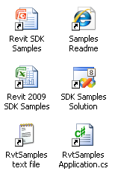
Managing Samples
Complete samples overview and readme
SamplesReadme.htm
Main samples solution
SDKSamples2009.sln
Knowledge base
Global search
Revit SDK samples spreadsheet
Revit_SDK_Samples.xlsx
External sample manager application
RvtSamples, a generic menu generator

Slide 11
SDK Samples Usage
Main tasks
Compile all projects
Load all projects into Revit
Search for solution to specific task
Main tools
Top-level search is supported by SamplesReadMe.htm
Compile and detailed search can be done in SDKSamples2009.sln
Load is handled by RvtSamples external application

Slide 12
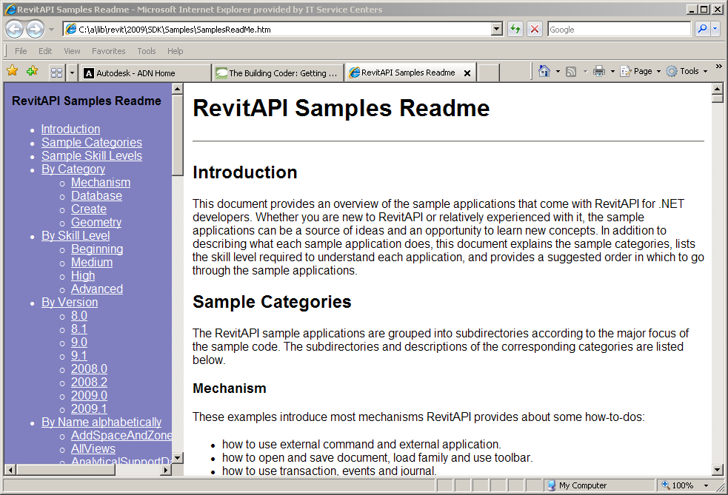
Complete overview and readme
Every sample in the Revit SDK includes a readme file
Always *.rtf, sometimes also *.txt
This documentation is dispersed
Rtf files are hard to search globally
Enter SamplesReadme.htm
Modelled on ObjectARX samples readme
All descriptions in one file
Additional categorisations
Unite with spreadsheet?

Slide 13
Main Samples Solution
All Revit SDK samples are united in SDKSamples2009.sln
Both C# and VB
Compiling all samples requires reference path to RevitAPI.dll
Installing Revit to default location matches default, otherwise adjust
Ensure 'Copy Local' flag is set to False
Use global searching to explore a specific programming task
Search for CreateWall
Whole word and match case
In Journaling, discover what we really want: NewWall()
Bare-bones external command requires adjusting Revit.ini
Effort to test all samples
Solution: RvtSamples external application
Notes:
Open SDK Samples solution; note that it contains both C# and VB projects. Search for CreateWall, note it appears many times, select whole word and match case, less hits, discover that the journaling sample actually calls the Revit API method NewWall, search for that, et voilà all samples that create walls. One remaining problem is that testing all the samples requires a lot effort in adjusting Revit.ini. In addition, it is impossible to add all the samples as individual external commands to Revit.ini at the same time, since that exceeds the maximum number of permitted menu entries.

Slide 14
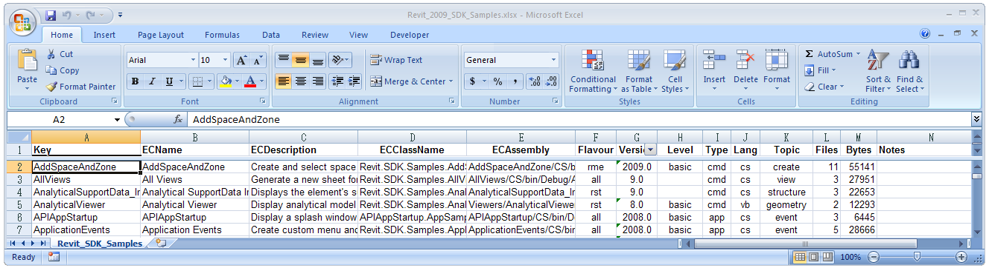
Revit Samples Spreadsheet
Excel spreadsheet listing all samples
Revit_SDK_Samples.xlsx
Includes the required Revit.ini EC data
Includes classification by various categories
Flavour: generic, rac, rst, rme
Version: 8.0, 8.1, 9.0, 9.1, 2008.0, 2008.2, 2009.0, 2009.1
Level: basic, intermediate, advanced
Type: cmd, app, exe
Language: cs or vb
Topic: creation, element, parameter, etc.
Files: number of source files
Bytes: total source file size
Notes:
Revit_SDK_Samples.xlsx is an Excel spreadsheet database of all the Revit SDK samples including all the EC or external command data required for creating the Revit.ini entries for invoking the samples as external Revit commands. It also manages additional information such as classification into different categories. This data is useful in itself to provide an overview of the samples. It can also be used to automatically generate Revit.ini entries to invoke the commands for test purposes. Last but not least, it is used to generate a text file RvtSamples.txt which is used as an input file by the RvtSamples external application to automatically generate a menu hierarchy including all SDK samples.
Open the spreadsheet, look at the classifications.

Slide 15
RvtSamples
External application
Defines entire menu hierarchy
Generic menu generator
Used for additional ADN and BC material as well
Lists all Revit samples
Multiple categorisations
Database driven
Avoid hitting max. number of menu entries
Minimal edits in Revit.ini
Enhanced version supporting #include
http://thebuildingcoder.typepad.com/blog/2008/11/loading-the-building-coder-samples.html
Notes:
RvtSamples is a generic Revit menu generator which reads a text file RvtSamples.txt listing all the Revit SDK samples categorised in various ways and creates a new top level hierarchical menu providing simultaneous access to all of them.
It is not limited to the SDK samples, you can add any other menu entry definitions you like, as well as or instead of the predefined ones for the SDK samples. For instance, in my system, I have added entries to define a second complete menu hierarchy for all the ADN, AU and The Building Coder samples.
RvtSamples is implemented as an external application and thus requires only a minimal edit of Revit.ini, an addition of two or maximally four lines, as opposed to the hundreds of lines required if you want to add the SDK samples individually. It defines its own menu hierarchy, which can be completely freely defined by the driving text file. Using the default database driven input file, it generates entries for all SDK samples, categorised in several different ways, e.g. by Revit flavour and original release version. It circumvents the maximum limit of about 50 entries that can be made to the Tools > External Tools submenu. Open the project, look at how to create menu entries, debug through steps in reading RvtSamples.txt and generating the menu hierarchy.
Open RvtSamples, look at how to create menu, debug through steps in reading RvtSamples.txt and generating menu and menu entries.
I have implemented an enhanced version of RvtSamples which supports an #include statement, similar to the functionality provided by the C and C++ language preprocessor. I use it to include my own regularly updated collection of samples. I have two collections of samples that I regularly work on and add to: the ADN and the Building Coder collections. To load them, I simply add the following two lines at the end of RvtSamples.txt:
#include C:/a/j/adn/train/revit/2009/src/AdnSamples.txt
#include C:/a/j/adn/train/revit/2009/src/bc/BcSamples.txt

Slide 16
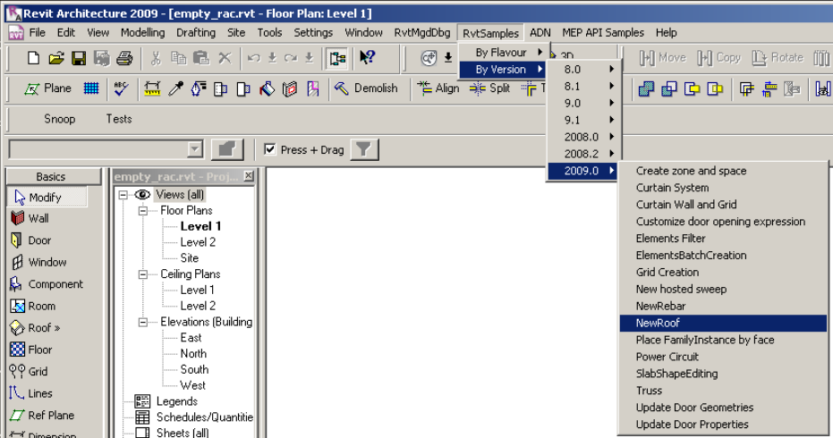
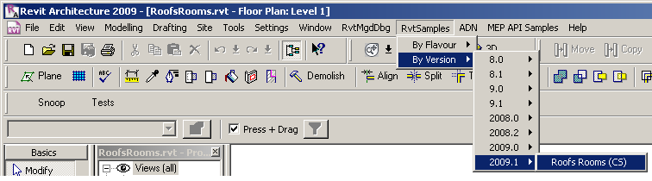
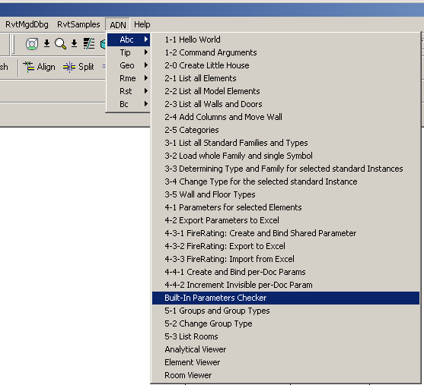
RvtSamples
Notes:
Here is a view of the RvtSamples menu hierarchy displaying the 2009 samples; they are arranged in two separate classifications, by topic and by version. Here is another view after the addition of the RoofsRooms sample in the 2009 web update 1. The menu entitled ADN is the additional menu created by #including my own additional text files at the end of the original RvtSamples.txt.

Slide 17
SDK Samples Overview

Slide 18
Revit SDK Samples
Huge knowledge base … most of the Revit SDK information is contained in the samples ... impossible to discuss each and every one ...
APIAppStartup
AddSpaceAndZone
AllViews
AnalyticalSupportData_Info
ApplicationEvents
ArchSample
AreaReinCurve
AreaReinParameters
AutoTagRooms
BarDescriptions
BeamAndSlabNewParameter
BlendVertexConnectTable
BoundaryConditions
BrowseBindings
CreateBeamSystem
CreateBeamsColumnsBraces
CreateComplexAreaRein
CreateDimensions
CreateShared
CreateSimpleAreaRein
CreateViewSection
CreateWallinBeamProfile
CreateWallsUnderBeams
CurtainSystem
CurtainWallGrid
CurvedBeam
DeckProperties
DeleteDimensions
DeleteObject
DesignOptionReader
DoorSwing
ElementsBatchCreation
ElementsFilter
FamilyExplorer
FireRating
FoundationSlab
FrameBuilder
GenerateFloor
GridCreation
HelloRevit
HelloWorld
ImportExport
InPlaceMembers
InplaceFamilyAnalyticalModel3D
InvisibleParam
Journaling
LevelsProperty
Loads
MaterialProperties
Materials
ModelLines
ModifyIniFile
MoveLinear
NewHostedSweep
NewOpenings
NewPathReinforcement
NewRebar
NewRoof
ObjectViewer
Openings
ParameterUtils
PathReinforcement
PhaseSample
PhysicalProp
PlaceFamilyInstanceByFace
PowerCircuit
ProjectInfo
ProjectUnit
RDBLink
ReferencePlane
Reinforcement
RevitCommands
RoofsRooms
RoomSchedule
Rooms
RotateFramingObjects
RvtSamples
ShaftHolePuncher
SharedCoordinateSystem
SlabProperties
SlabShapeEditing
SpanDirection
SpotDimension
StructSample
StructuralLayerFunction
TagBeam
TestFloorThickness
TestWallThickness
Toolbar
TransactionControl
TagBeam
TestFloorThickness
TestWallThickness
Toolbar
TransactionControl
Truss
TypeSelector
VersionChecking
ViewPrinter
Viewers/AnalyticalViewer
Viewers/ElementViewer
Viewers/RoomViewer
VisibilityControl
Notes:
As already stated, the Revit SDK includes over one hundred different sample applications, demonstrating just about all of the functionality provided by the Revit API. This constitutes a huge knowledge base, and makes it important for every Revit developer to know how to manage and search the information provided. The samples are currently the main source of information on how to solve specific programming tasks in the Revit API. Whenever faced with a new Revit API issue, one of the first places to search for information is in the samples collection. Most tasks that can be accomplished through the API are illustrated by one of them. Obviously we will not be able to discuss each and every one of these in detail in this session. This section presents a chronological categorisation matching the development of the API itself, followed by some details on specific groups of samples.
The rest of the presentation provides a slightly more detailed first impression of selected samples. Since we cannot discuss every one, we will focus on some important basic samples useful for initial exploration of the Revit API features and suitable for beginners, and on the new samples added in the Revit 2009 time frame, which are of interest to developers who have already worked with the API and explored the ones that have been available for longer. The information we present is extracted from the global readme file provided in SamplesReadme.zip and in the individual sample documentation files Readme*.rtf.

Slide 19
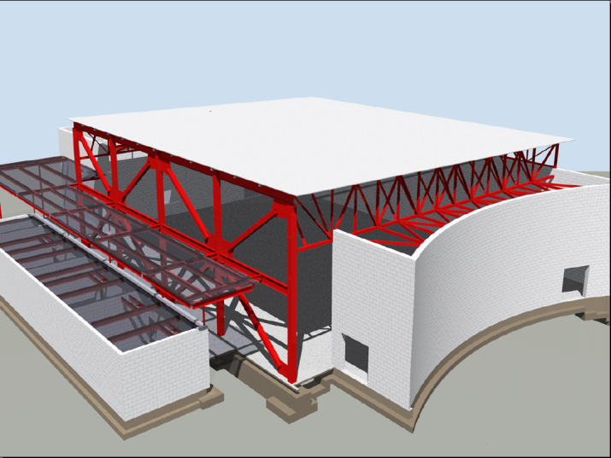
Basic Revit SDK Samples
ArchSample All
BrowseBindings All
CreateShared All
FireRating All
HelloRevit All
MoveLinear All
PhysicalProp All
RevitCommands All
StructSample All
TypeSelector All
ElementViewer All
RoomViewer All
AnalyticalViewer Rst
Notes:
These samples existed before Revit 9.0. Many of them were originally written using a COM API, which is no longer supported by Revit. They are all migrated to .NET now. With each sample, we also list the flavours of Revit it applies to, either Rac, Rme, Rst or All.
The samples listed above are often introductory in nature and provide a good starting point for initial exploration of the API. They are comparable to the Revit API Introduction labs, which constitute an alternative place to start such an exploration (cf. Learning More). The labs are more systematic than the basic samples, whereas the basic samples provide useful stand-alone functionality and more or less complete coverage. The basic samples often demonstrate access and analysis functionality, whereas creation of new element was added later and was a focus of the Revit 9.0 and 9.1 API releases. The following paragraphs highlight some of the important topics to explore when starting work with the Revit API. Remember that all the information presented here as well as a complete overview of all samples including a categorisation listing the basic samples is also available in SamplesReadMe.htm.

Slide 20
Revit 9.0 SDK Samples
AllViews All
AnalyticalSupportData_Info Rst
AreaReinCurve Rst
AreaReinParameters Rst
BarDescriptions Rst
BeamAndSlabNewParameter Rst
CreateBeamsColumnsBraces All
CreateComplexAreaRein Rst
CreateDimensions All
CreateSimpleAreaRein Rst
CreateViewSection Rst
CreateWallinBeamProfile Rst
CreateWallsUnderBeams Rst
DeleteDimensions All
DeleteObject All
DesignOptionReader All
GenerateFloor All
InPlaceMembers Rst
LevelsProperty All
Loads Rst
MaterialProperties All
ObjectViewer All
PhaseSample All
RotateFramingObjects All
SlabProperties Rst
StructuralLayerFunction Rst
VersionChecking All
Notes:
The sample categorisation into the different flavours of Revit is not always trivial. Some samples demonstrate features that work in all flavours of Revit, such as the creation of walls or section views, but rely on some flavour-specific detail for simplified calculation purposes, such as CreateViewSection and CreateWallsUnderBeams which make use of the RST analytical model.

Slide 21
Revit 9.1 SDK Samples
FrameBuilder All
Journaling All
ModelLines All
Openings All
ReferencePlane All
Rooms All
SharedCoordinateSystem All
BoundaryConditions Rst
CreateBeamSystem Rst
FoundationSlab Rst
Materials Rst
ObjectViewerII Rst
Reinforcement Rst
Notes:
Here is an overview of the Revit 9.1 SDK samples, sorted by Revit flavour and alphabetically. ModelLines and Materials were originally provided in two versions each, suffixed with 1 and 2. Later, in the 2008.2 update, these separate variations were united into one each. ObjectViewerII was removed in the 2008.2 SDK update, being very similar to ObjectViewer.

Slide 22
Revit 2008 SDK Samples
Described in
SDK/Samples/Revit 2008 New Samples.doc
APIAppStartup
ApplicationEvents
AutoTagRooms
BlendVertexConnectTable
CurvedBeam
FamilyExplorer
ImportExport
InplaceFamilyAnalyticalModel3D
NewOpenings
NewPathReinforcement
PathReinforcement
Added in 2008.2
RDBLink
RoomSchedule
ProjectInfo
ProjectUnit
ShaftHolePuncher
SpotDimension
TagBeam
TestFloorThickness
TestWallThickness
Toolbar
TransactionControl
ViewPrinter
VisibilityControl
Notes:
The samples added in Revit 2008 and in the Revit 2008.2 SDK update are described in a separate document in the Revit 2008 SDK, "Revit 2008 New Samples.doc".
ImportExport was originally named ImportExportDWG, and renamed in the 2009 timeframe when more formats were added.

Slide 23
Revit 2009 SDK Samples
All
CurtainSystem
ElementsBatchCreation
ElementsFilter
GridCreation
ImportExport
NewRoof
PlaceFamilyInstanceByFace
RvtSamples
SlabShapeEditing
RAC and RME (2009.1)
RoofsRooms
RAC
CurtainWallGrid
DoorSwing
NewHostedSweep
RME
AddSpaceAndZone
PowerCircuit
RST
NewRebar
Truss
Notes:
16 new samples were added to the initial release of the Revit 2009 SDK. One of these is RvtSamples, discussed above, which can be used to load all other samples into Revit.exe for testing and debugging. Another important 2009 sample that every developer should explore is ElementsFilter, because almost every application needs to make use of the new element filtering introduced in the Revit 2009 API. For the first time, we also have some RME-specific samples, as well as the RAC and RST ones. The RoofsRooms sample was added to the Revit SDK in the 2009.1 SDK update in the summer of 2008, matching the Revit 2009 web update 1.

Slide 24
Basic Revit SDK Samples
Notes:
The rest of the presentation provides a quick overview and a first impression of each sample. This information is extracted from the global readme file provided in SamplesReadme.zip and in the individual sample documentation files Readme*.rtf.

Slide 25
Basic Samples
Introductory
Pre-dating Revit 9.0
Good place to start looking at API
Comparable to Revit API Introduction labs
Labs are more systematic
Complete coverage
Not much for element creation
That became focus of later API releases

Slide 26
Interactive Element Selection
In 2008, explicit interactive element selection functionality was added
Current implicit selection set is passed to the command
Selection set can be changed from the command
If error returned, error set is highlighted
RevitCommands.Selection
ElementSet selSet = rvtApp.ActiveDocument.Selection.Elements;
Notes:
Before Revit 2008, explicit interactive element selection functionality was not available through the API. The pre-selected implicit selection set is passed in to the command. From 2008 onwards, the selection set can be changed from an external command. If an external command returns an error, the error set is highlighted and an optional message is displayed in the Revit user interface. This is demonstrated by the RevitCommands Selection sample, accessible by selecting an element and then executing Tools > External Tools > RevitCommands - Selection or RvtSamples > By Version > 8.0 > RevitCommands.Selection.

Slide 27
Object Properties
Generic properties provide access to
Type parameters
Instance parameters
Both include shared parameters (more later)
RevitCommands.ElementData
Dim instanceParams As Revit.ParameterSet = elem.Parameters
Dim typeParams As Revit.ParameterSet = elem.ObjectType.Parameters
Dim loc As Revit.Location = elem.Location
Dim geomElem As Revit.Geometry.Element = elem.Geometry
Notes:
The Revit API uses generic properties to provide access to type and instance parameters. Both may include shared parameters. One sample to begin exploring this topic is the RevitCommands ElementData sample.

Slide 28
Import and Export Data
Export to file or other applications such as Excel
Element and Type Properties
Location and Geometry
Samples
Simplest: ArchSample
Basic: FireRating, Revit Intro Labs 4
Advanced: RDBLink
Notes:
Exporting and importing data to or from a file or other applications such as Excel is a frequent requirement. Data such as element and type properties, location, and geometry may be exported and imported. The simplest sample demonstrating this is ArchSample, which exports to Excel. A more advanced but still basic sample is FireRating, which creates a new shared parameter for storing application specific data in the Revit model, exports it to Excel, and imports modified data from Excel back into and updates the Revit model. Finally, an advanced sample in this area is RDBLink.

Slide 29
Custom Data Addition
Use shared parameter mechanism
Add custom data, i.e. new parameters
Add to new and existing elements and types
Data can be hidden
FireRating (vb) and Lab 4-3 (cs + vb) commands
Apply Parameter
Export to Excel
Import from Excel
Revit.Parameters.Definition = ... ‘ e.g. Integer
Parameters.Binding = app.Create.NewInstanceBinding(categorySet) ‘ e.g. Doors
rvtApp.ActiveDocument.ParameterBindings.Insert(definition, binding)
Notes:
Application specific custom data, i.e. new parameters, can be added to the Revit model using the shared parameter mechanism. An application can add to new and existing elements and types. The data can be hidden from the user interface. The SDK samples FireRating in VB and the Revit API Introduction Lab 4-3 in both C# and VB demonstrate this by defining three commands:
Apply Parameter
Export to Excel
Import from Excel

Slide 30
Element Modification
Move and rotate elements
Swap element types programmatically
Groups
Generic property access
Move Linear command
Type Selector command
FireRating shows parameter editing
Notes:
Some basic requirements are to move and rotate elements, swap element types programmatically, manage groups of elements, and generic property access. This is demonstrated by the Move Linear and Type Selector commands, among others.

Slide 31
Load Families and Types
Load whole family
Load specific family symbol aka type
Search for families and types loaded in doc
RevitCommands Load Family and Load Family Symbol commands
rvtApp.ActiveDocument.LoadFamily(fileName)
rvtApp.ActiveDocument.LoadFamilySymbol(fileName, symbolName)
Notes:
Revit makes strong use of families and types. Loading a whole family and a specific family symbol or type as well as searching for already loaded families and types in the current document is demonstrated by the RevitCommands Load Family and Load Family Symbol commands.

Slide 32
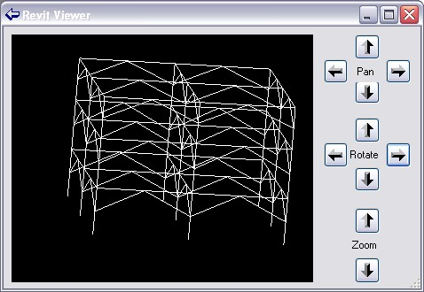
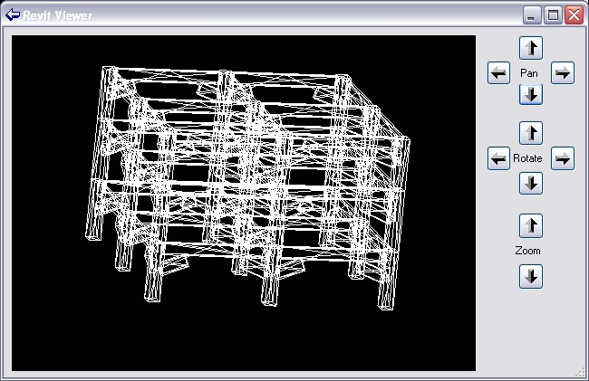
Viewers
AnalyticalViewer Rst
ElementViewer All
RoomViewer All
RevitViewer Utility
ObjectViewer All + Rst
Viewing elements
Analytical model
Physical model
Notes:
A good starting point for exploring the different types of geometry of Revit elements is provided by the geometry viewer samples. The Revit SDK currently includes the following viewers:
AnalyticalViewer
ElementViewer
RoomViewer
RevitViewer
ObjectViewer
All the viewers query a selected Revit element for some specific geometry, traverse it, break it down into simple line segments, and render those into a .NET System.Windows.Forms PictureBox. They can all be classified as pretty basic samples. The first four of these are all located in the subdirectory Viewers and are implemented in VB. They were introduced early on in the Revit API, with version 8.0. Of these four, the RevitViewer is a helper class, which implements the actual viewer window which is used by the other three to present three different views of certain subsets of the building model. ObjectViewer was introduced later, in the Revit 9.0 SDK, is written in C#, and defines its own rendering window. Below is an example of the form defined by RevitViewer; in this case, it is being driven by the ElementViewer sample and displaying the wall with a door and two little windows created by the external command defined by Lab2_0_CreateLittleHouse in the Revit API introduction labs. The form looks identical when driven by the AnalyticalViewer and RoomViewer samples, only the content displayed differs.
The AnalyticalViewer is for Revit Structure, to view the analytical building model. The analytical model is generally a simplified approximation of the building structure for structural analysis purposes, which is of most interest to the structural engineer. Revit Structure maintains the analytical model in parallel with the physical model, which is what architects and most other people are interested in.
ElementViewer is designed for all flavours of Revit and displays the standard element geometry.
RoomViewer is a viewer for displaying the two-dimensional outline of a room boundary.
Just like the three viewers, just discussed, ObjectViewer demonstrates viewing elements. It allows the user to select between the analytical and physical model, and also which view to display. You might thus say that it is a combination of the AnalyticalViewer and the ElementViewer with some additional features.
ObjectViewer includes both generic functionality usable in all Revit flavours, as well as some Revit Structure specific functionality. It displays a selected single element in a preview window and retrieves geometry from either the analytical or physical model. It also includes some additional useful odds and ends such as defining an own error message exception handling class and some unit handling functionality. ObjectViewer was originally introduced in Revit 9. Another very similar sample named ObjectViewerII was introduced in 9.1. ObjectViewerII was removed in the 2008.2 SDK update, being very similar to ObjectViewer.
For all of the viewers, the steps to run are similar: simply select the element whose geometry or the room whose boundary to display and start the external command. The analytical viewer will check whether any analytical model is available, which requires Revit Structure functionality. In the case of the ObjectViewer, all display views are listed, the detail level can be selected, and analytical and physical model can be switched.

Slide 33
Revit 9.0 SDK Samples

Slide 34

Revit 9 API Features
Significant API Features
Element Creation
Extended list of creatable elements
All family based elements
Wall, Floor, Level, Grid
Track Changes
Visually display changes performed by the 3rd party application
Let user accept or reject the changes
Notes:
So in terms new API features displayed there on your screen, it looks like there’s not a lot to see really, but as we all know the newly added to Element creation list is a massive inclusion. We can now create Walls, Floors, Levels, Grids and all Family Based Elements which means that the Revit API is now becoming a very powerful API indeed.
We also have the new Track Changes feature, which at the moment is only available in Revit structure. What it does is to track certain changes to elements across a single API external command, allowing the user to revert the changes back to what they were before a user ran your command. The way you revert a change is by Right-clicking the element you want to revert, and you should see the reversion options displayed there.

Slide 35
Revit 9 New Objects
Elements
AreaReinforcement
AreaReinforcementCurve
Dimension
LoadCaseArray/Iterator
LoadUsage
LoadUsageArray/Iterator
View
View3D
ViewDrafting
ViewSection
ViewSet/Iterator
ViewSheet
Symbols
AreaReinforcementType
DimensionType
Objects
ExternalCommandData
Geometry
BoundingBoxXYZ
ConicalFace
CylindricalFace
DoubleArray/Iterator
HermiteFace
PlanarFace
Reference
ReferenceArray/Iterator
RevolvedFace
RuledFace
Structural
AnalyticalSupportData
AnalyticalSupportInfo
AnalyticalSupportInfoArray/Iterator
BarDescription

Slide 36
New Creation Methods
AreaReinforcement
Dimension
Structural family instances
Floor
Grid
Level
LoadCase
LoadCombination
LoadNature
LoadUsage
View3D
ViewDrafting
ViewSection
ViewSheet
Wall
Notes:
LoadNature is used to define the type of load as Dead, Live, Seismic, Wind etc.
LoadUsage is used for visibility of loads only.

Slide 37
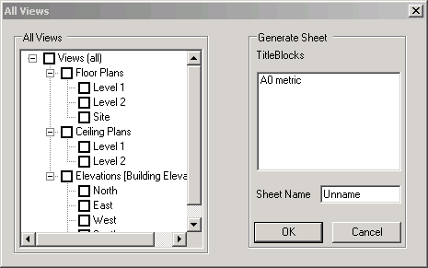
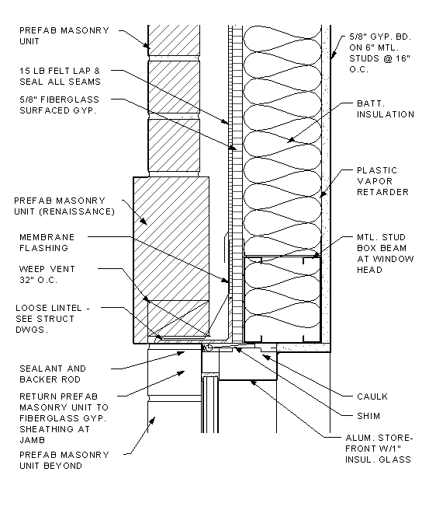
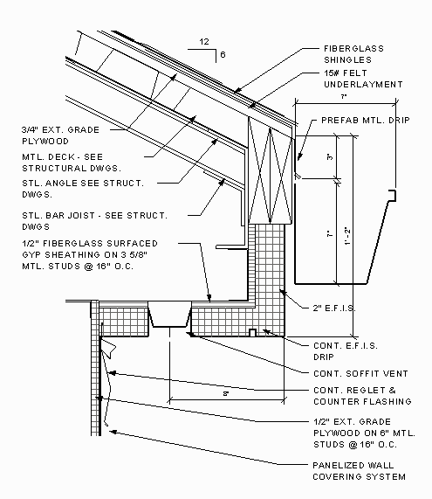
Sheets and Views
AllViews – All
Find all views in project and display in tree view
Create a new sheet with selected views
Demonstrate creating a ViewSheet via NewViewSheet()
Notes:
This sample finds all the views in a project and displays the names in a tree view hosted by the modal dialog that is displayed. The user can select several of the views and when OK is clicked a new sheet is generated that has all the selected views placed in it correctly sized, scaled and aligned.
When the command is executed a dialog appears that contains the following:
a) A tree view represents all the views’ names.
b) A list of all title blocks.
c) An edit box for the sheet’s name.
Note: All views should represent by category, not including schedules, sheets.
Loading the drawing Training\Metric\m_RST_SAVE DETAIL.rvt allows me to produce new sheets of all the elevations.
Extra Usage Notes:
draw a simple model.
check the current status of views and sheet. If there is no sheet, fine.
run the command.
choose views. Click ok.
check under Sheets. You can see a sheet where the selected views are placed.

Slide 38
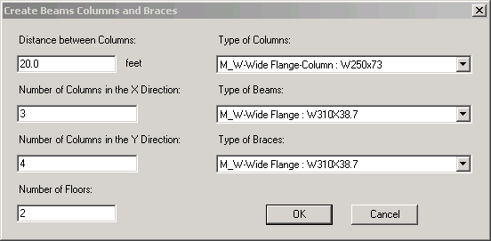
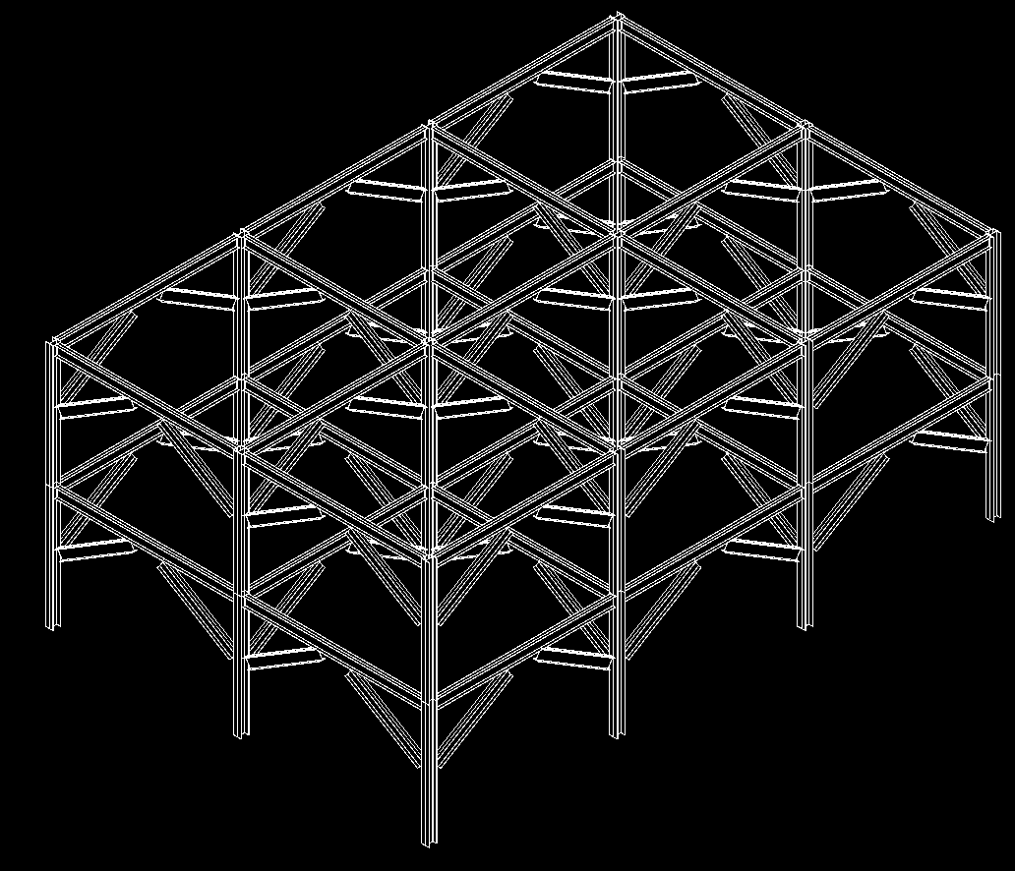
Beams, Columns and Braces
CreateBeamsColumnsBraces – All
Use NewFamilyInstance() to create structural elements
STRUCTURALTYPE stType = StructuralType.Beam;
// create the beam
FamilyInstance beam = doc.Create.NewFamilyInstance( ref pt, beamType, topLevel, stType );
// assign the location curve to the beam
LocationCurve beamCurve = beam.Location as LocationCurve;
if( null != beamCurve )
{
Line line = app.Create.NewLineBound( ref startPoint, ref endPoint );
beamCurve.Curve = line;
}
Notes:
This sample demonstrates the creation of new objects, in particular the NewFamilyInstance(). Notice that there’s some code below which shows how it’s done.
So lets take a look at the sample to see what it does exactly. Create a new project. Pick elevations to create 5 new levels, run the program.

Slide 39
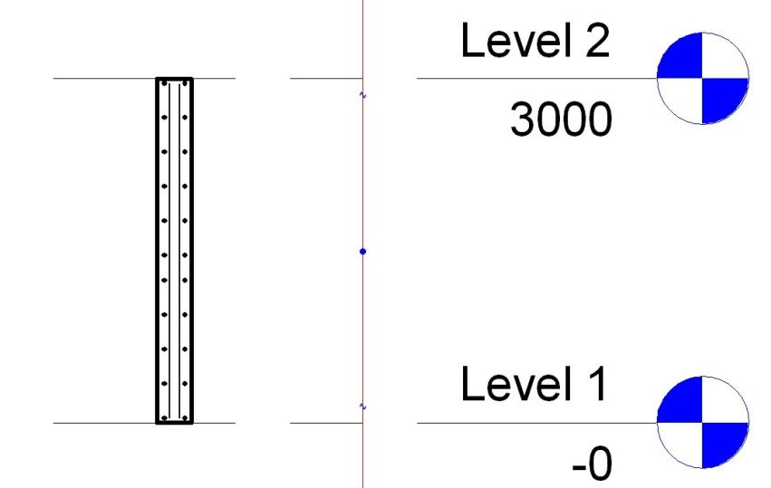
Area Reinforment
CreateSimpleAreaRein – Rst
Demonstrate creation of AreaReinforcement element
Uses NewAreaReinforcement()
Works on slab or wall
AreaReinforcementType symbol = dataOnWall.AreaReinType as AreaReinforcementType;
DocCreator creator = m_revit.Application.ActiveDocument.Create;
// create the area reinforcement
AreaReinforcement areaRein = creator.NewAreaReinforcement( symbol, wall, refer, curves );
Notes:
This sample creates an Area Reinforcement in a rectangular shape on a slab or wall.
Go to 3d view, then draw a wall/floor.
Select it, and execute the command. Accept default and ok. It will add a rebars to the wall/floor. (But it may not be visible.)
Move the cursor to the centre of the wall. You will see a "x" mark with "structural area reinforcement". This is what is added.
Goto Level1, then try creating a section. (View --> New --> Section). if you zoom in the section of a wall, you will see rebars placed inside of the wall.

Slide 40
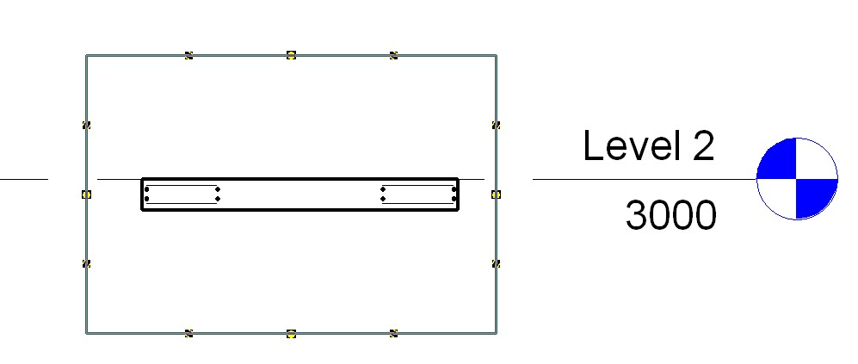
Area Reinforcement
CreateComplexAreaRein – Rst
Demonstrate creation of AreaReinforcement element
Uses NewAreaReinforcement()
Defines opening/cutout in slab
Only works on slab
Notes:
This sample is very similar CreateSimpleAreaRein, except that it generates a much more complex reinforcement detail and only works for a slab or floor.
The detail is created with all four layers of reinforcement defined and with two nested rectangular curve loops so that it defines a rectangular cutout opening.
On the interior 4 curves, set the override flag and flip the hooks on the top 2 layers to ‘up’, so the bars can hook into some walls around that opening.

Slide 41
Dimensions
CreateDimensions – All
DeleteDimensions – All
Demonstrate creation and deletion of a dimension
Uses NewDimension()
// create dimension line geometry
Line newLine2 = new Line( ref point1, ref point2, true );
// create the actual dimension
Dimension newDimension = doc.Create.NewDimension(
doc.ActiveView, newLine2, referenceArray );
Notes:
This sample requires a basic wall to be drawn and selected in order to function.
NOTE: If you are going to use this same inside Structural be aware that, by default, Basic Walls are NOT displayed unless you turn them on. Goto View properties -> Discipline, here it will be set to either Structural or Analytical (this excludes anything not having that model type property) – simply change it to "Architectural" .

Slide 42
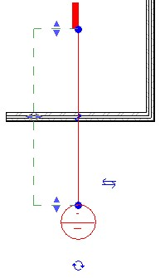
Section View
CreateViewSection – All
Demonstrate creation of a detail view
Uses NewViewSection()
Creates detail view across the midpoint of selected element
Works on linear element such as slab, wall or beam
// Create a section view:
ViewSection section = m_project.Create.NewViewSection( box );
Notes:
Next we have the CreateViewSection sample; this sample provides a tool for generating a section view across the mid point of a selected element. Draw a wall, beam or floor then select it to run the application.

Slide 43
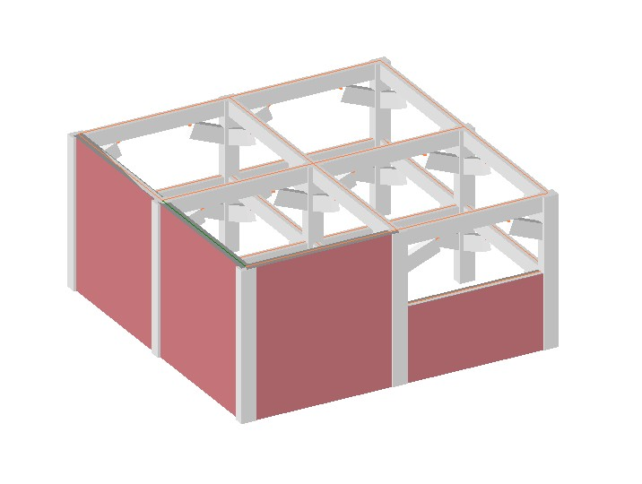
Walls
CreateWallsUnderBeams – All
Demonstrates creation of walls under selected beams
Uses NewWall()
Illustrates the AnalyticalModelFrame class
How to convert from physical model
Notes:
Create Beams Columns and Braces in Revit Structure. Select one or more of the beams and run the CreateWallsUnderBeams sample. This will create the walls, to show them, switch the shade mode to shaded.

Slide 44
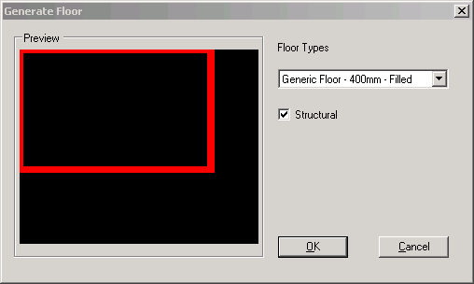
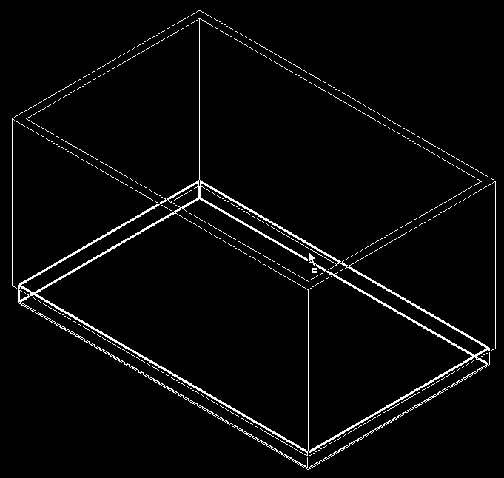
Floors
GenerateFloor – All
Demonstrates the creation of a floor or slab
Analyses wall geometry
Lists applicable floor types
Uses NewFloor()
// Create a new floor
Floor f = doc.Create.NewFloor( data.Profile,
data.FloorType, data.Level, data.Structural );
Notes:
This sample is very straight forward, you draw a closed room and run the command. You may get the Floor drawn on Level2 so set the properties of each of the walls so that the top constraint is level1 with a base offset of 0.0. Draw a wall, beam or floor then select it to run the application.

Slide 45
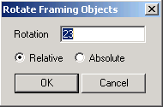
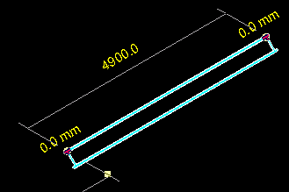
Rotation
RotateFramingObjects – All
Demonstrates how to rotate elements
Uses parameter access
// in case of a column
bool result = pointLocation.Rotate( rotateAxis, rotateDegree );
Notes:
This sample is a minimal sample which simply shows how to rotate objects selected from a Revit model via the API. It’s minimal, but answers a frequently asked question. Use Create Beams Columns and Braces to generate some test geometry, now you can run RotateFramingObjects nicely.

Slide 46
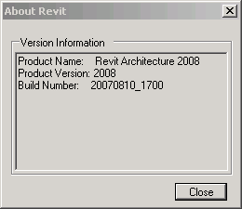
Product Version
VersionChecking - All
Demonstrates how to access the running product version
The most requested API feature!
Allows developers to channel functionality
Data is built into the Application class
Version name
Version number
Version build

Slide 47
Revit 9.1 SDK Samples

Slide 48
Revit 9.1 API Features
Access to journal file
Regression testing
Improved handling of units
Conversion between user interface and internal Revit database units
Ability to suspend updating
Model can be changed or updated through the API with minimal impact on speed
Significant performance improvements to element transformations
New Elements
ModelLine, Material, Opening, ReferencePlane, SketchPlane
Notes:
The information in this presentation has been extracted from the SDK document “Getting Started.doc” and from analysis of the Revit 9.1 SDK samples themselves.
Here are the new features common to both architecture and structure.
There are additional features specific to either one of the two as well. More new elements have been added for structure, we will see those in a moment.
Journal file:
The journal file records all input parameters obrtained from the user during a session. These can be used to rerun a similar session later on without any user interaction. This feature is useful for regression testing, both for Revit itself and for external programs. Therefore, external programs now have read and write access to the data in the Revit journal file.
Units:
DisplayUnitSystem = Is Revit set up to show units in metric or Imperial
DisplayUnitType = Returns the display units for a value
AsValueString = Returns the value properly formatted in the same way that Revit would format the text

Slide 49
Rac 9.1 API Features
Access to rooms
Find
Tag
Notes:
Access to rooms have been added which will provide the user with the ability to find rooms that have been defined by the user and number of tag them.
Rooms:
Autodesk.Revit.Elements.Room.Number
Autodesk.Revit.Elements.RoomTag
Autodesk.Revit.Creation.Document.NewRoom
Autodesk.Revit.Creation.Document.NewRoomTag

Slide 50
Rst 9.1 API Features
Define and access boundary conditions
New elements
Boundary Conditions
Beam systems
Path Reinforcement
Ability to define reinforcement bar sets

Slide 51
Revit 9.1 API Fixes
NewArc() added to API
Improved Span Direction API
Track changes no longer highlights type changes to the same type
Delete methods now return the ids of the elements deleted
Grid lines are now available immediately after creation
Significant performance improvements to element transformations through SuspendUpdating functionality
Notes:
Here is a list of some of the improvements made to existing functionality. Nothing really important if you have not happened to run into a problem with this in an earlier release.

Slide 52
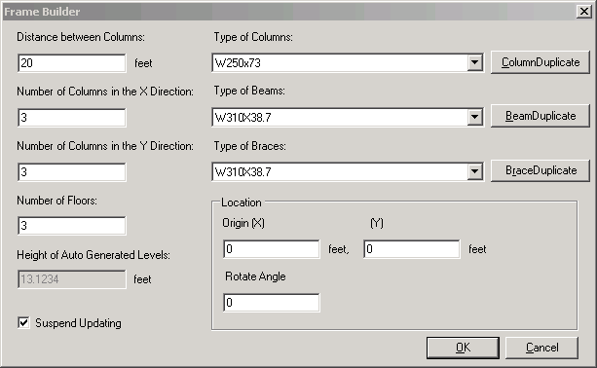
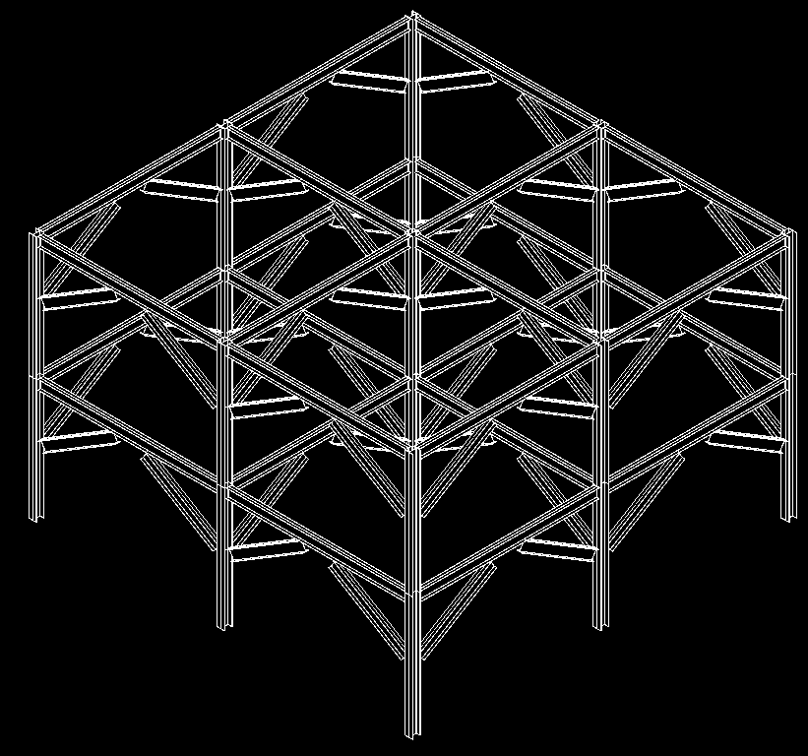
FrameBuilder
FrameBuilder – All
Composed of floors, levels, columns, beams, braces
Demonstrates methods
NewLevel(), NewFamilyInstance()
Illustrates the SuspendUpdating mechanism
New SuspendUpdating( doc ), SuspendUpdating.Dispose()
Notes:
This sample is very similar to CreateBeamsColumnsBraces sample. It is enhanced with SuspendUpdating. Also, it creates its own levels if some are missing.
SuspendUpdating mechanism is used to avoid display updating within an operation so as to improve performance. It’s usually used when many entities are created in a single command. Simply run the command in an empty or non-empty drawing, either in architecture or structure.
As far as I know, following is all the API operations SuspendUpdating covers currently:
1. apiRotate (4 overloads)
2. apiMove (4 overloads)
3. apiMirror (5 overloads)
For above transformation operations, SuspendUpdating can benefit performance much when operating on a single element many times in a loop.
But please notice: for batch operation — perform such operations on an ElementSet, because it calls regen only once, suspendupdating do not promote performance any more.
4. Leader
Revit::Leader::End::set
Revit::Leader::Elbow::set
5.FamilyInstance
Revit::Elements::FamilyInstance::StructuralUsage::set
Revit::Elements:: FamilyInstance::flipHand()
Revit::Elements::FamilyInstance:: flipFacing()
Revit::Elements:: FamilyInstance:: Rotate()
6.IndependentTag
Revit::Elements::IndependentTag::TagHeadPosition::set
Revit::Elements::IndependentTag::LeaderElbow::set
Revit::Elements::IndependentTag::LeaderEnd::set
7.TextNote
Revit::Elements::TextNote::Coord::set
Revit::Elements::TextNote::Width::set
8.Wall
Revit::Elements::Wall::WallType::set
Set some parameter may call regen. But parameter change is not covered by suspendupdating currently.

Slide 53
Journaling Mechanism
Journaling – All
All user actions in Revit are recorded in the journal file
C:\Program Files\Autodesk Revit Structure 4\Journals
To rerun journal file
Drag it onto Revit icon
Drag it onto open session
Pass it as command line parameter
Integrating an external application
Add and retrieve information to and from journal file
StringStringMap Autodesk.Revit.ExternalCommandData.Data
StringStringMap.Insert()
StringStringMap.Item()
Example application adds a wall and saves its data
VBScript-like, work around missing API issues
Notes:
This sample demonstrates the journaling mechanism, integrating an external application into the Revit journaling environment and adding and retrieving information to and from the Revit journal file.
Demonstrates NewLine(), NewWall(), StringStringMap.Insert() used by ExternalCommandData.Data property, the data map that can be used to read and write data to the Autodesk Revit journal file.
1. Run this sample in Revit for the first time. It will ask the user for some data to create a wall, and then record the data into the revit journal file.
Select any wall type, level 2, (0,0,0), (10,0,0).
The journal data is written to
C:\Program Files\Autodesk Revit Building 9.1\Journals\
2. Start Revit from the command line with the path to the journal file as a parameter, or drag and drop the file onto Revit. This sample reads the data in the journal file and recreates a same wall in Revit.
"C:\Program Files\Autodesk Revit Building 9.1\Program\Revit.exe" "C:\Program Files\Autodesk Revit Building 9.1\Journals\journal.0031.txt"
Case ID 1211118 [How to use the journal file]
Revit SPR #122247 some of Journal files in Structure Test Models won't re-play
C:\Program Files\Autodesk Revit Building 9.1\Journals\ >..\Program\Revit.exe journal.0036.txt
Regression Testing
Unknown to many, Autodesk Revit records the operations that the user performs into a text file known as a Journal file. These files can then be used to playback the same operations if Revit is started with the journal filename as part of the command line. If the results of the operations in Revit differ from those that were previously recorded the application will stop and note the failure in the resulting journal file. This process of creating a journal file and then playing it back to ensure that operations remain the same is known as Regression Testing and is quick and simple way of ensuring that you application does not differ from previous known to work versions.
User interface interaction during the external command are not recorded in the journal file so a mechanism has been provided to store a limited mount of data within the journal file when the command finishes so that that data can be passed to the external command when executed via the journal file. The commandData object that is passed to the external command now has a Data property that contains a String to String map to hold such data. If your application sets values in this map they will become stored in the journal file. If this data member contains data when your command is executed then your application should read this data and assume it is being operated from a journal file without user interaction and hence should not pause for any user input at any time thus ensuring that the command can be played back completely programmatically.
Note: currently there is a limitation on the amount of data that can be placed in the Data map.
How to use the Journal File for Regression Testing
All the user actions in a Revit session are recorded to a journal file.
The Journal file is usually located in the Journal folder of the Revit Installation. (Example C:\Program Files\Autodesk Revit Structure 4\Journals)
To rerun the journal file simply drag the file on top of the Revit icon on your desktop or into an open session of Revit.

Slide 54
Model Lines
ModelLines – All
Report the number of instances of each model line type
Create new model lines
Arc, Ellipse, Line, NurbSpline
New and Modified Classes and Methods
Autodesk.Revit.Elements.ModelCurveArray
Autodesk.Revit.Elements.ModelCurveArrayIterator
Autodesk.Revit.Elements.ModelCurve
Autodesk.Revit.Elements.ModelArc
Autodesk.Revit.Elements.ModelEllipse
Autodesk.Revit.Elements.ModelLine
Autodesk.Revit.Elements.ModelHermiteSpline
Autodesk.Revit.Elements.ModelNurbSpline
Autodesk.Revit.Creation.Document.NewModelCurve
Autodesk.Revit.Creation.Document.NewModelCurveArray
Autodesk.Revit.Creation.Application.NewArc
Notes:
In Revit 9.1, we have the possibility to create model lines and curves through the API. In order to create a model line, we have to create the underlying geometry line or curve first. For some of the complex curve types, there is no method available to create the geometry curve from scratch, so those types of model curves have to obtain their underlying geometry corve from some existing object.
The model curve types supported are arc, ellipse, line and hermite and nurb splines.
The hermite spline is required in order to import certain geometry from AutoCAD, it is normally not used by Revit itself.
The two samples are very similar. In ModelLines1, a new sketch plane is created for the new model lines, whereas in ModelLines2, the user may select an existing sketch plane.
Model Lines:
Autodesk.Revit.Elements.ModelCurveArray
Autodesk.Revit.Elements.ModelCurveArrayIterator
Autodesk.Revit.Elements.ModelCurve
Autodesk.Revit.Elements.ModelArc
Autodesk.Revit.Elements.ModelEllipse
Autodesk.Revit.Elements.ModelLine
Autodesk.Revit.Elements.ModelHermiteSpline
Autodesk.Revit.Elements.ModelNurbSpline
Autodesk.Revit.Creation.Document.NewModelCurve
Autodesk.Revit.Creation.Document.NewModelCurveArray
Autodesk.Revit.Creation.Application.NewArc

Slide 55
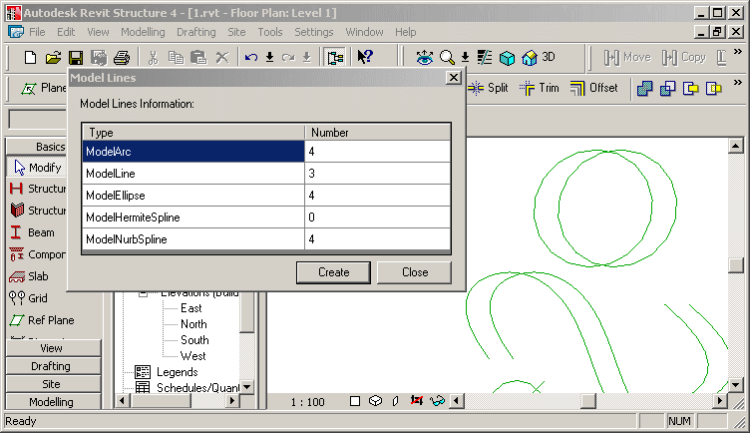
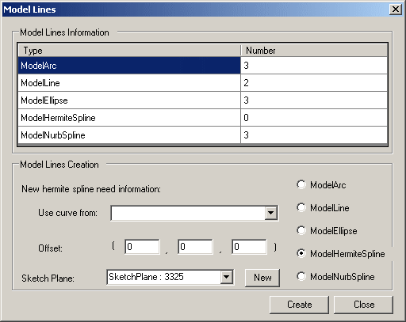
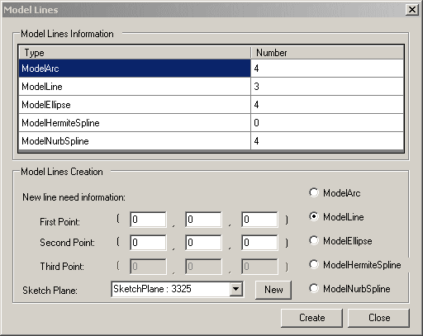
Model Lines
ModelLines – All
ModelLines1 - creates a new sketch plane for drawing the new model lines on
ModelLines2 - allows the user to select which existing sketch plane to draw the new lines on and data to use
You need to draw some ellipses and nurb splines before invoking the command. (these underlying geometry curves cannot be created with Revit API, yet.)
Notes:
Report the number of each model line type and allow the user to create one of each of the following in revit - Arc, Ellipse, Line, HermiteSpline and NurbSpline.
Makes use of Autodesk.Revit.Elements.ModelCurveArray.cs and an own helper class ModelCurveCounter.
Demonstrates the API calls NewSketchPlane(), NewArc(), NewLine(), NewModelCurve(), NewCurveArray(), NewModelCurveArray(),
Draw some ellipses, hermite and nurb splines before invoke the command, because the geometry curves of these cannot be created with Revit API.
Creates a new sketch plane for drawing the new model lines on.
ModelLines2 is similar to ModelLines1, but allows the user to select which existing sketch plane to draw the new lines on.

Slide 56
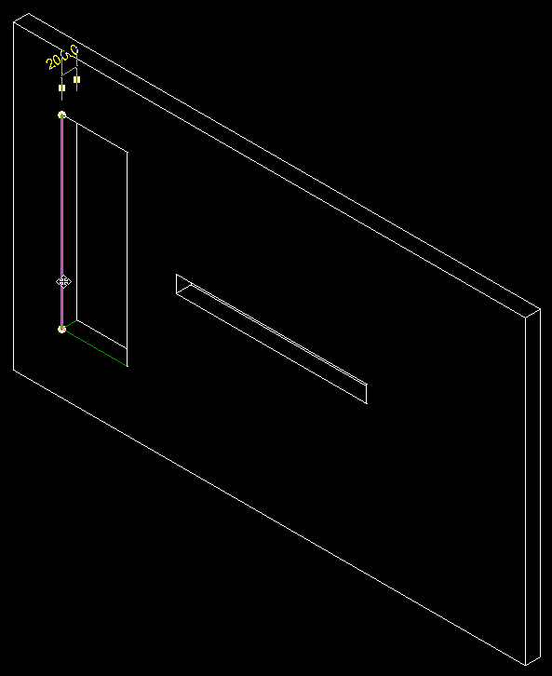
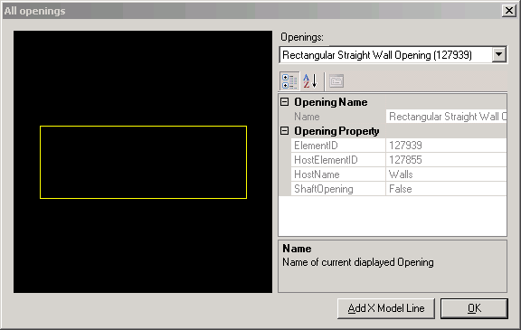
Openings
Openings – All
New API calls to access openings
Using family based elements or shafts
Sample displays openings and creates model lines on edges
Generic and Opening-specific helper classes
Vector, UCS, Line2D, Line3D, LineSketch, ObjectSketch
WireFrame to implement an own little mini graphics system
OpeningProperty, OpeningInfo
Notes:
Draw a wall, add one tall narrow and one low wide opening, run the command.
In the dialogue box, you can select any one of the openings in the model. It is displayed in a preview window. Clicking ‘Add X Model Line’ causes the application to draw model lines on the edges of the opening. For a rectangular opening in a planar wall, this will draw 12 model lines.
Bug: the model lines are in the wrong place if the wall is not axis aligned.
How to see the model lines created by this sample after running it? Use the tooltips on the 12 edges of the selected opening.
Description: Display openings in project and create X model lines on them.
Readme:
Autodesk Revit API application: Openings
This is a really minimal sample that shows how to get the property of an opening, show its profile in preview a window and create model lines on it. All the interesting code is in Openings project. Openings.cs contains the code to implement drawing. The WireFrame class retrieves the element profile.
To build the *.dll, edit project properties and make sure additional reference component include the Revit.dll in Revit Structure 4 installation directory. Then, paste the contents of Revit.ini into Revit.ini. Launch Revit, note the Tools -> External Tools -> Openings Commands menu.
This sample implements some generic helper classes Vector, UCS, Line2D, Line3D, LineSketch, ObjectSketch, WireFrame to implement an own little mini graphics system:
Vector: Point class use to store point coordinate value and get the value via (x, y ,z)property.
UCS: User coordinate system.
Line2D, Line3D: Line classes to represent a geometry segment line.
ObjectSketch: base class of sketch object to draw 2D geometry object, manages bounding box, pen and transformation.
LineSketch: sketch line and any tag on it.
WireFrame: class to generate the model lines and fit the picture box's size to display.
This sample implements some Opening-specific helper classes OpeningProperty, OpeningInfo
bug:
start revit
open 1.rvt
start openings
select one opening
select create x lines
close the dialogue
--> one opening is displayed on the revit screen with a black background
click View > Refresh
--> the whole screen turns black
it only happened once, when i was debugging a lot, and suspended the computer midway.

Slide 57
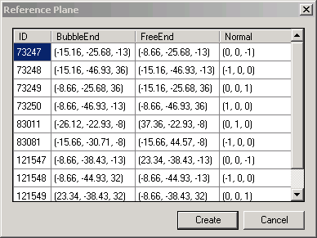
Reference Plane
Reference Plane – All
Report all reference planes in the current project
Show their ID, bubble end, free end, and normal
ReferencePlane class
Create a new reference plane at the left face of the selected wall or at the bottom of selected slab
NewReferencePlane() method
Notes:
I ran this in C:\a\j\adn\train\revit\mep\test\Urban House MEP.rvt.
Reference Planes and Sketch Planes
Autodesk.Revit.Creation.Application.NewPlane
Autodesk.Revit.Creation.Application.NewPlane
Autodesk.Revit.Creation.Document.NewReferencePlane
Autodesk.Revit.Creation.Document.NewReferencePlane2
Autodesk.Revit.Creation.Document.NewSketchPlane

Slide 58
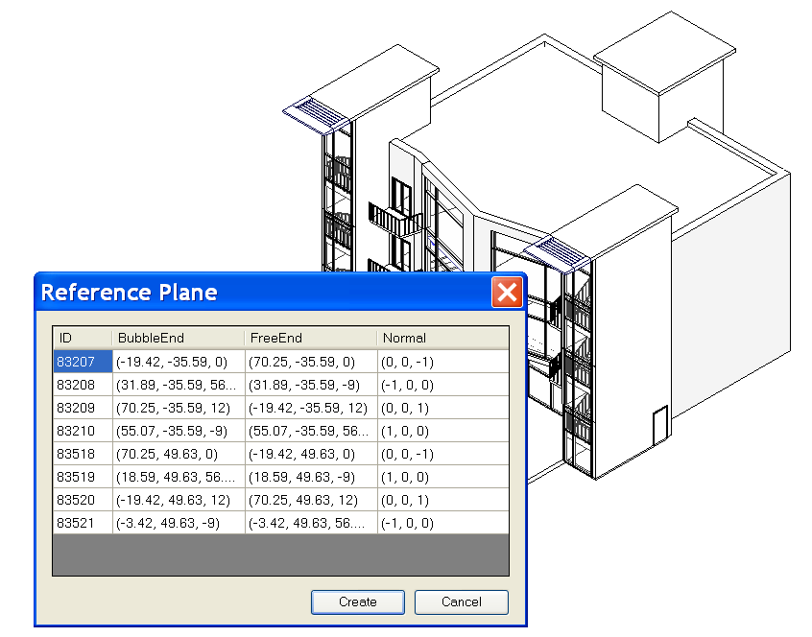
Reference Plane
Reference Plane – All
Notes:
Steps:
0. Open a .RVT file containing reference plane objects, e.g m_CoHouse.rvt in the training folder.
1. Run the external command.
2. A dialog will appear to report all reference planes in the current project, showing its ID, bubble end, free end, and normal.
3. If a wall or a slab is selected before the command is run, when Create button is clicked, a reference plan will be created at the left face of the wall or at the bottom of the slab.
4. After the new reference plan is created, we can list it out by running the command again.

Slide 59
Accessing Room Elements
Rooms – All
Report room information: ID, Name, Number, Level, Department, Area, Have tag
Room class
Create a tag for a room if it has none
NewRoomTag() method
Notes:
Rooms:
Autodesk.Revit.Elements.Room.Number
Autodesk.Revit.Elements.RoomTag
Autodesk.Revit.Creation.Document.NewRoom
Autodesk.Revit.Creation.Document.NewRoomTag

Slide 60
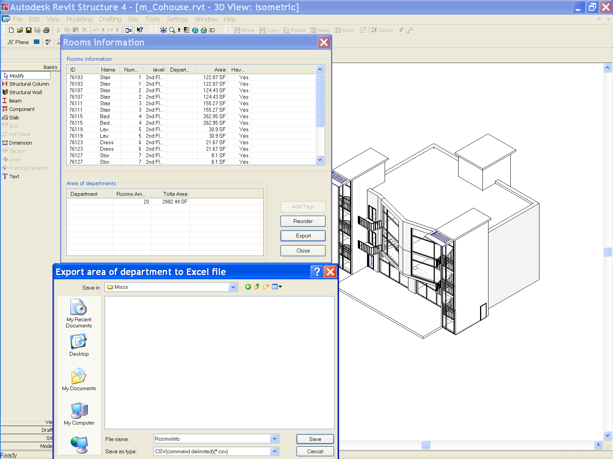
Accessing Room Elements
Rooms – All
Notes:
Steps:
0. Open a .RVT file containing room objects, e.g m_CoHouse.rvt in the training folder.
1. Run the command. A dialog will display the information of all rooms.
2. Create room tags and add them to the rooms which are lack of tags.
3. Reorder the number of all rooms by ascending order from ground floor to high floor, from left to right.
4. Calculate the rooms area for each department and export the result to an Excel document.
Why are there duplicates in the list above?

Slide 61
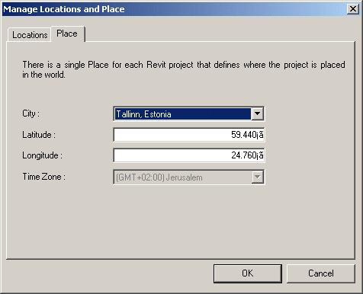
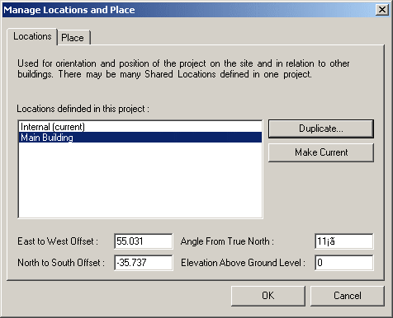
Location and Place
SharedCoordinateSystem – All
Display project location and site information
Similar to UI access, now API is available as well
[Settings] --> [Manage place and locations...]
Notes:
Display the locations and site information of the project.
1. Show the project location and site information for current project.
2. Users can set the values to change the location.
3. In the Project Browser, open a 2D plan view of the project. Click View menu and select View Properties, set the view orientation to True North.
4. On the Tools menu, click Shared Coordinates and select Acquire Coordinates.
To avoid the warning that timezone.txt could not be found, copy
R:\Samples\SharedCoordinateSystem\CS\timezone.txt
to
R:\Samples\SharedCoordinateSystem\CS\bin\Debug\timezone.txt
(1) where do you see this in UI.
This sample seems to be duplicating a two dialogs that you see in:
[Settings] menu --> [Sun and Shadows settings...] --> [Still] tab in [Name] --> click on the right-down arrow next to the [Place] under [By Date, Time and Place] toggle button,
You will see the very similar dialog there.
Actually, a better place to reach this info in UI is
[Setting] --> [Manage place and locations]
(2) what you see with External command?
If you duplicated the site location in the external command, you will see it there in the UI, too.
(3) implications
This is added for the Japanese developer who is developing Sun and Shadow Analysis. (Mikako logged this wish for GSA) In Japan, Sun and Shadow Analysis is the Must document. While revit has a long list of locations in ww, you couldn't have a more precise locations in earlier versions. (I think this is enhancement in UI, too. I don't remember exactly how it looked though...) So the developer can add more cities in Japan for exact locations.
The UI seems the same as 9.0, but there was no API to access this in the past.

Slide 62
Boundary Conditions
BoundaryConditions – Rst
Define and access boundary condition in the model
New and modified classes and methods
Autodesk.Revit.Elements.BoundaryConditions
Autodesk.Revit.Creation.Document.NewPointBoundaryConditions
Autodesk.Revit.Creation.Document.NewLineBoundaryConditions
Autodesk.Revit.Creation.Document.NewLineBoundaryConditions
Autodesk.Revit.Creation.Document.NewAreaBoundaryConditions
Autodesk.Revit.Creation.Document.NewAreaBoundaryConditions
Notes:
Now we come to the structure-only samples.

Slide 63
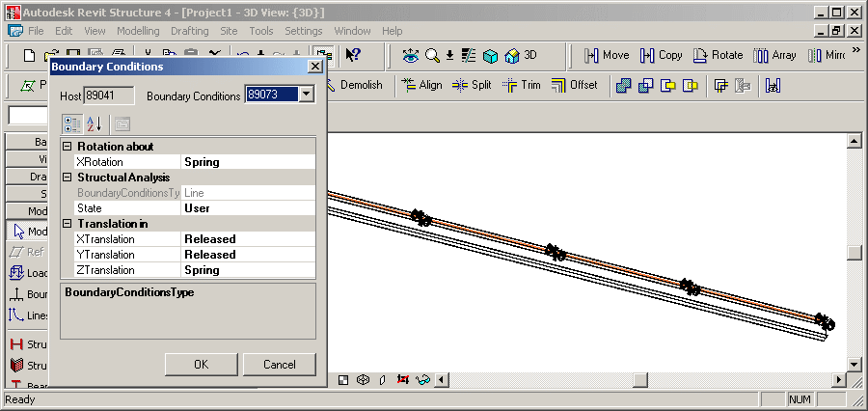
Boundary Conditions
BoundaryConditions – Rst
Display boundary conditions parameters
Create new boundary conditions
Notes:
Create a Structural Wall or Beam element.
Open a 3D view to see the analytical model, pointing out that no boundary conditions are set.
Select it.
Invoke the command.
Since it has no boundary conditions to start with, new ones are created and can be modified through the dialogue.
Set some boundary conditions.
Close the dialogue and point out that BCs have been added.
Autodesk Revit API application: BoundaryConditions
1. Firstly, user should select a structure element.
2. Invoke external command.
3. If the selected element has boundary conditions the parameters of the boundary conditions (BC) are presented. And users are also allowed to set these parameters with other valid values.
4. If the selected element does not have a BC then create one.
The sample set the conversion between the internal value and display value fit to Imperial unit.
Create a few walls in structural. Select one of them. Start the command.
The command checks whether exactly one element has been preselected and exits with an error message otherwise.
The method IsStructuralElement() determines whether the selected element is structural. To do so, it checks whether its class is one of FamilyInstance, Wall, Floor, or ContFooting, and whether it has a non-null AnalyticalModel property.
The boundary conditions for the selected element are collected from the database and saved in a dictionary in a BoundaryConditionsData instance, which also knows the host element, the dictionary key BC id.
If no boundary conditions have been set for the selected element, a suitable set of BCs are created when loading the form, in BoundaryConditionsForm_Load().
New boundary conditions are created by CreateBoundaryConditions(): point, line, and area.
Exercise the new API calls NewPointBoundaryConditions(), NewLineBoundaryConditions(), NewAreaBoundaryConditions().
The BoundaryConditionsData class has a member data object BCProperties which determines the data displayed by the ui PropertyGrid.
BCProperties knows about certain BC parameter values rules according to the Revit main program as well.
This sample also includes some sample boundary condition families: Boundary Conditions Fixed.rfa, Boundary Conditions Pinned.rfa, Boundary Conditions Roller.rfa, Boundary Conditions User.rfa
These families seems to be similar to the built-in boundary conditions?
This sample seems to be similar to the built-in boundary conditions command?

Slide 64
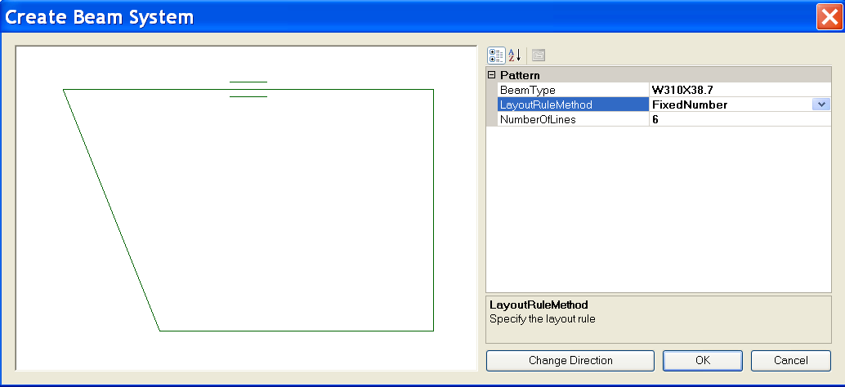
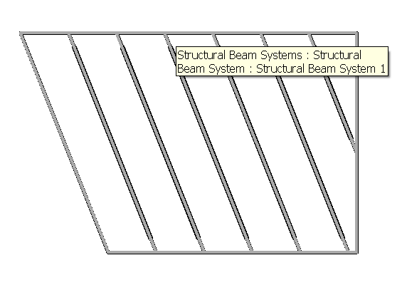
Create Beam System
CreateBeamSystem – Rst
Demonstrate creation of a beam system
Based on some connected framing beams
Uses NewBeamSystem()
Illustrates the BeamSystem class
How to convert from physical model
Notes:
Steps:
0. Create a few beams connecting to each other to form a loop.
1. Select all these beams before running the command.
2. Invoke the external command.
Choose layout method and beam type in the dialog.
Change the direction of the beam system if necessary.
Click OK button to create the beam system.
Note: The spacing of the beam system may not be easy to specify especially when you create the beams on the fly. You can choose FixedNumber LayoutRuleMethod in the Create Beam System dialog to make things easier.
Beam Systems:
Autodesk.Revit.Elements.BeamSystem
Autodesk.Revit.Elements.LayoutRule
Autodesk.Revit.Elements.LayoutRuleFixedDistance
Autodesk.Revit.Elements.LayoutRuleFixedNumber
Autodesk.Revit.Elements.LayoutRuleMaximumSpacing
Autodesk.Revit.Elements.LayoutRuleClearSpacing
Autodesk.Revit.Creation.Document.NewBeamSystem

Slide 65
Create Foundation Slab
FoundationSlab – Rst
Create octagonal foundation slabs for selected floors at the base of the building
Demonstrate Autodesk.Revit.Creation.Document.NewFloor()
Parameter BuiltInParameter.STRUCTURAL_FLOOR_ANALYZES_AS
'4' suggests foundation slab
Notes:
This sample requires a floor at the lowest level of the building.
In a new drawing, draw three structural walls forming a closed triangle. Draw a slab by walls on level 1, pick the three walls. Run the command.
(1) New drawing.
(2) Basics > Structural Wall > Click, Click, Click, Click.
(3) Double click Structural Plans > Level 1.
(4) Basics > Slab > Pick Walls > Click, Click, Click, Finish Sketch.
(5) Tools > External Tools > Foundation Slab.
This sample iterates over the current building model and assembles the following data:
// A set of levels to find out the lowest level of the building.
SortedList<double, Level> m_levelList = new SortedList<double,Level>();
// A set of views to find out the regular slab's bounding box.
List<View> m_viewList = new List<View>();
// A set of floors to find out all the regular slabs at the base of the building.
List<Floor> m_floorList = new List<Floor>();
// A set of regular slabs at the base of the building.
// This set supplies all the regular slabs' datas for UI.
List<RegularSlab> m_allBaseSlabList = new List<RegularSlab>();
// A set of the types of foundation slab.
// This set supplies all the types of foundation slab for UI.
List<FloorType> m_slabTypeList = new List<FloorType>();
It defines a helper class Sketch for drawing slabs and floors profiles into a WinForms PictureBox instance.
It calculates the bounding box of each floor, calculates an octagonal slab shape enclsing its bounding box.
On clicking OK, the original floor is replaced by an octagonal foundation slab.
Demonstrates the API call NewFloor().
Deletes the original floor.

Slide 66
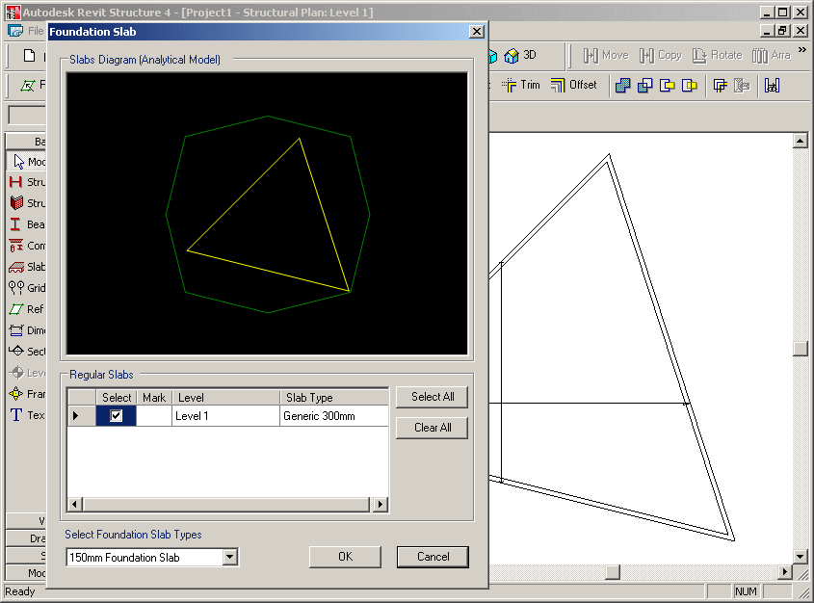
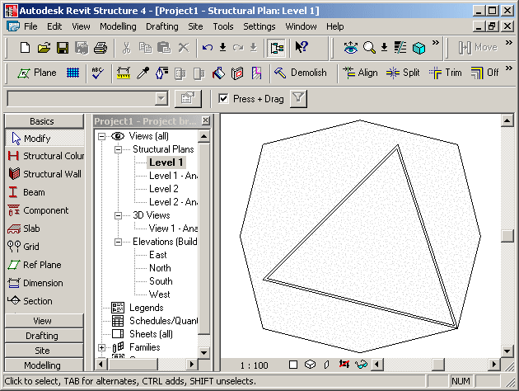
Foundation Slab
FoundationSlab – Rst
Extracts all floors and levels, determines lowest ones
Determines existing regular slab’s bounding box
Determines available foundation slab types
Implements a helper class Sketch for drawing slabs and floors profiles into a WinForms PictureBox instance
Calculates an enclosing octagonal slab shape

Slide 67
Structural Element Material
Materials – Rst
All available materials can be obtained by the property Materials of Setting object
All material parameters can be retreived using
Autodesk.Revit.Parameters.BuiltInParameter parameterId;
get_Parameter( parameterId );
One BuiltInParameter couples with one parameter
Structural Units are demonstrated as well
Materials2 is very similar to Materials1. No identity, misc. properties
Works with Structure – uses analytical model and “Beam Material”, “Column Material” properties
Currently, it won’t work with wall and floor: SPR #122487: Material API - doesn't reflect after changed
Notes:
Materials:
Autodesk.Revit.Color
Autodesk.Revit.FillPatternSet
Autodesk.Revit.FillPatternSetIterator
Autodesk.Revit.MaterialSet
Autodesk.Revit.MaterialSetIterator
Autodesk.Revit.Materials
Autodesk.Revit.Elements.FillPattern
Autodesk.Revit.Elements.Material
Autodesk.Revit.Elements.MaterialConcrete
Autodesk.Revit.Elements.MaterialGeneric
Autodesk.Revit.Elements.MaterialOther
Autodesk.Revit.Elements.MaterialSteel
Autodesk.Revit.Elements.MaterialWood
Autodesk.Revit.Settings.FillPatterns
Autodesk.Revit.Settings.Materials
Autodesk.Revit.Creation.Application.NewFillPatternSet
Autodesk.Revit.Creation.Application.NewColor
Autodesk.Revit.Creation.Document.NewMaterialSet

Slide 68
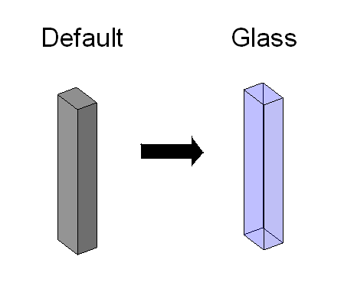
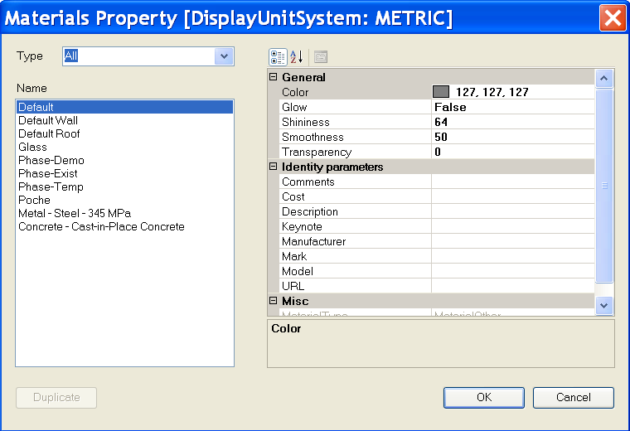
Structural Element Material
Materials – Rst
Notes:
Steps:
0. Create a structure element such as a column.
1. Select the structure element.
2. Run the external command.
3. All available materials in the current project will be listed out in a form.
4. Choose a material other than the previous one and press OK button.
5. The material of the structure element will be changed.
Note: Users can duplicate a concrete material which is not light weight.
Materials:
Autodesk.Revit.Color
Autodesk.Revit.FillPatternSet
Autodesk.Revit.FillPatternSetIterator
Autodesk.Revit.MaterialSet
Autodesk.Revit.MaterialSetIterator
Autodesk.Revit.Materials
Autodesk.Revit.Elements.FillPattern
Autodesk.Revit.Elements.Material
Autodesk.Revit.Elements.MaterialConcrete
Autodesk.Revit.Elements.MaterialGeneric
Autodesk.Revit.Elements.MaterialOther
Autodesk.Revit.Elements.MaterialSteel
Autodesk.Revit.Elements.MaterialWood
Autodesk.Revit.Settings.FillPatterns
Autodesk.Revit.Settings.Materials
Autodesk.Revit.Creation.Application.NewFillPatternSet
Autodesk.Revit.Creation.Application.NewColor
Autodesk.Revit.Creation.Document.NewMaterialSet

Slide 69
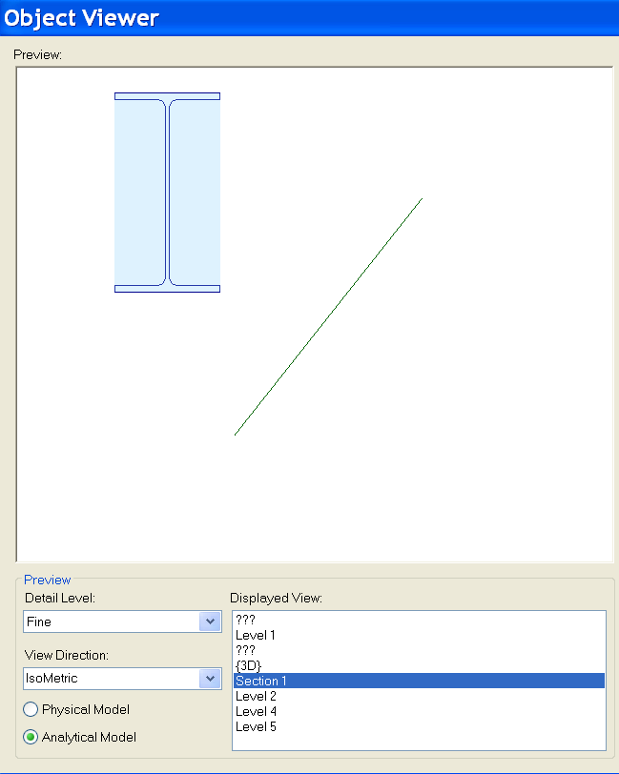
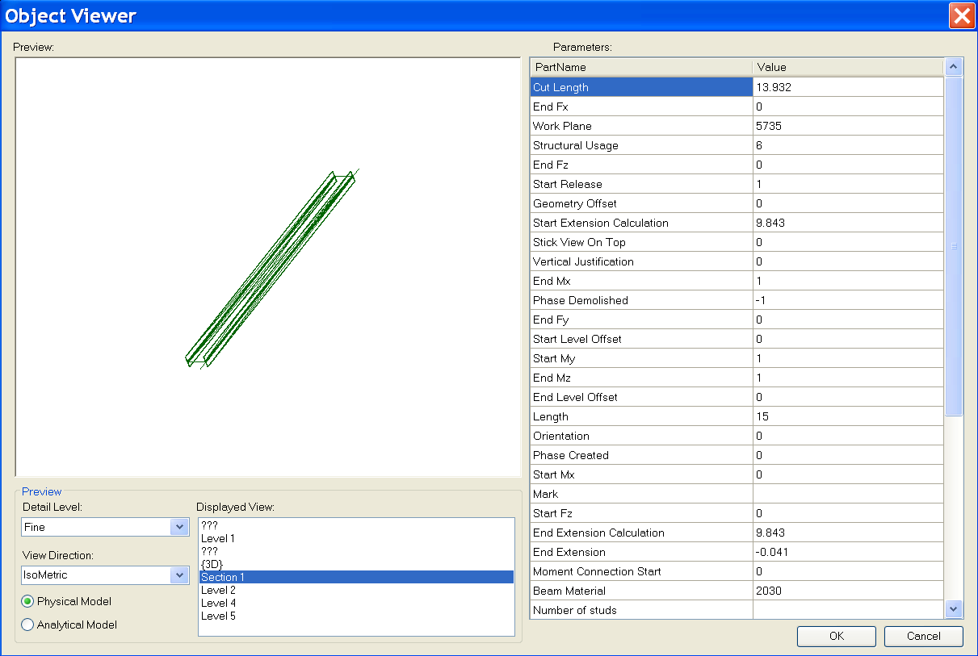
ObjectViewer
ObjectViewer – was ObjectViewerII – All + Rst-specific functionality
Display a selected single element in a preview window
Retrieve geometry from both physical and analytical model
Define an own error message exception handling class
Demonstrate unit handling
Notes:
Steps:
1. Select a structure element such as a beam.
2. Run the external command.
3. All Display Views are listed out. Detail Level can be chosen; Physical Model and Analytical Model can be switched.

Slide 70
Rebar in a Beam or Column
Reinforcement – Rst
Path reinforcement classes and methods
Autodesk.Revit.Elements.PathReinforcementCurve
Autodesk.Revit.Elements.PathReinforcement
Autodesk.Revit.Symbols.PathReinforcementType
Autodesk.Revit.Elements.SketchPlan
Autodesk.Revit.Elements.ReferencePlane
Autodesk.Revit.Elements.Opening
Autodesk.Revit.Geometry.Plane

Slide 71
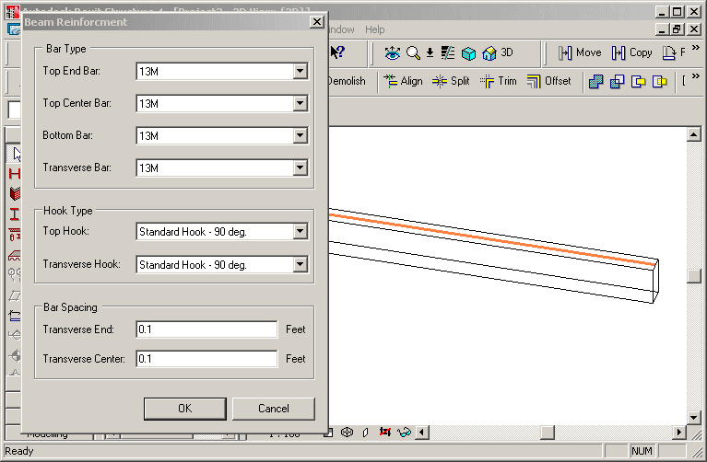
Rebar in a Beam or Column
Reinforcement – Rst
Create reinforcement rebars in selected non-reinforced concrete beam or column
Beam rebar: top, bottom or transverse
Column rebar: transverse or vertical
Notes:
Start Revit Structural, create a concrete beam, run the command.
Create reinforcement rebars on the selected concrete beam or column without reinforcement.
Create bar set in a selected concrete element (beam or column) that does not have any reinforcement.
1. Create bar set in a selected concrete element (beam or column) that does not have any reinforcement.
2. Beam rebar should be three kinds: top rebar, bottom rebar and transverse rebar.
3. Column rebar should be two kinds: transverse rebar and vertical rebar.
The class FrameReinMakerFactory does all the work, such as perform precondition testing
and create a corresponding FrameReinMaker and the reinforcement rebars.
Precondition checks include: is the selected object a beam or column, is it made of concrete, does it already contain any Rebar elements.
Two further classes do the work depending on host type: BeamFramReinMaker and ColumnFramReinMaker.
GeomUtil: basic geometric utility methods.
GeometrySupport: base class for BeamGeometrySupport and ColumnGeometrySupport, manages the solid of beam or column, the extend or sweep path of the beam or column, the director vector of beam or column, lists to store the edges and points, the transformation etc.
ParameterUtil: utility methods find or set certain parameter.

Slide 72
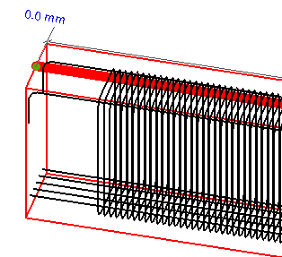
Rebar in a Beam or Column
Reinforcement – Rst
FrameReinMakerFactory class does all the work
Precondition checks
Is the selected object a beam or column?
Is it made of concrete?
Does it already contain any rebar elements?
Create a corresponding FrameReinMaker and the reinforcement rebars
Host-dependant working classes
BeamFramReinMaker and ColumnFramReinMaker
GeomUtil
Basic geometric utility methods
GeometrySupport
Base class for BeamGeometrySupport and ColumnGeometrySupport, manages the solid of beam or column, the extend or sweep path of the beam or column, the director vector of beam or column, lists to store the edges and points, the transformation etc.
ParameterUtil
Utility methods find or set certain parameter
Notes:
Start Revit Structural, create a concrete beam, run the command.
Create reinforcement rebars on the selected concrete beam or column without reinforcement.
Create bar set in a selected concrete element (beam or column) that does not have any reinforcement.
1. Create bar set in a selected concrete element (beam or column) that does not have any reinforcement.
2. Beam rebar should be three kinds: top rebar, bottom rebar and transverse rebar.
3. Column rebar should be two kinds: transverse rebar and vertical rebar.
The class FrameReinMakerFactory does all the work, such as perform precondition testing
and create a corresponding FrameReinMaker and the reinforcement rebars.
Precondition checks include: is the selected object a beam or column, is it made of concrete, does it already contain any Rebar elements.
Two further classes do the work depending on host type: BeamFramReinMaker and ColumnFramReinMaker.
GeomUtil: basic geometric utility methods.
GeometrySupport: base class for BeamGeometrySupport and ColumnGeometrySupport, manages the solid of beam or column, the extend or sweep path of the beam or column, the director vector of beam or column, lists to store the edges and points, the transformation etc.
ParameterUtil: utility methods find or set certain parameter.

Slide 73
Units
New and updated methods
Autodesk.Revit.Document.DisplayUnitSystem
Autodesk.Revit.Parameter.DisplayUnitType
Autodesk.Revit.Parameter.AsValueString
Notes:
Improved handling of units
Shelter the user from the internal Revit database units
DisplayUnitSystem = Is Revit set up to show units in metric or Imperial
DisplayUnitType = Returns the display units for a value
AsValueString = Returns the value properly formatted in the same way that Revit would format the text
Units:
Autodesk.Revit.Document.DisplayUnitSystem
Autodesk.Revit.Parameter.DisplayUnitType
Autodesk.Revit.Parameter.AsValueString

Slide 74
Revit 2008 SDK Samples

Slide 75
APIAppStartup
Demonstrates start up and shut down events (C#)
Interface IExternalApplication
public class AppSample : IExternalApplication
IExternalApplication.OnStartup() event
IExternalApplication.Result
IExternalApplication.OnStartup(ControlledApplication application)
{
String version = application.VersionName;
// display splash window for 10 seconds
SplashWindow.StartSplash();
SplashWindow.ShowVersion(version);
System.Threading.Thread.Sleep(10000);
SplashWindow.StopSplash();
return IExternalApplication.Result.Succeeded;
}
IExternalApplication.OnShutdown() event
IExternalApplication.Result
IExternalApplication.OnShutdown(ControlledApplication application)
{
MessageBox.Show("Quit External Application");
return IExternalApplication.Result.Succeeded;
}
Notes:
Note:
Please do not forget to use the latest version of the APIAppStartup sample. Its beta version is INCOMPLETE!
It works with both Architecture and Structure.
In the callback of the IExternalApplication.OnStartup() event, displays a splash screen.
In the callback of the IExternalApplication.OnShutdown() event, displays a dialog box.

Slide 76
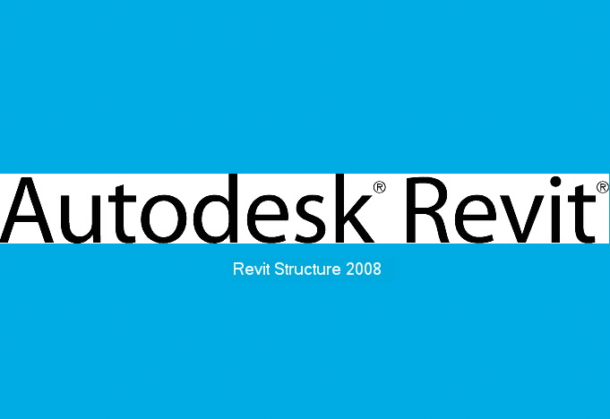
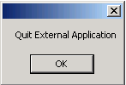
APIAppStartup Demo
Notes:
Steps:
1. Make sure the sample is registered as an external application. For example:
[ExternalApplications]
EACount=1
EAClassName1=APIAppStartup.AppSample
EAAssembly1=C:\Revit\SDK\Samples\APIAppStartup\bin\Debug\APIAppStartup.dll
2. Launch Revit 2008. Notice the splash screen will show up.
3. Quit Revit. Notice the dialog will show up.
4. Click OK to exit.

Slide 77
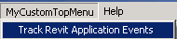
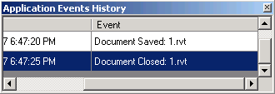
ApplicationEvents
Subscribe to application events and create custom menus (C#)
Modeless dialogue handling
Classes
Autodesk.Revit.Events.ApplicationEvents
Autodesk.Revit.MenuItem
Autodesk.Revit.Application
Autodesk.Revit.Document
Events
DocumentClosedEventHandler
DocumentOpenedEventHandler
DocumentSavedEventHandler
DocumentSavedAsEventHandler
Interface
public class RevitApplicationEvents : Autodesk.Revit.Events.ApplicationEvents
Event callbacks
public RevitApplicationEvents(Application app)
{
if (null != app)
{
app.OnDocumentClosed += new DocumentClosedEventHandler(OnDocumentClosed);
app.OnDocumentOpened += new DocumentOpenedEventHandler(OnDocumentOpened);
app.OnDocumentSaved += new DocumentSavedEventHandler(OnDocumentSaved);
app.OnDocumentSavedAs += new DocumentSavedAsEventHandler(OnDocumentSavedAs);
}
m_eventsLog = CreateEventsLogTable();
}
Notes:
The sample creates one custom top level menu and one sub-menu when Revit application starts up and uses this sub menu to show or hide a modeless window which displays the Revit application object events’ history log.
This sample will subscribe to Application’s document open, close, save and save as events.
This sample lists document’s opened, closed, saved or saved as information in a modeless window when the document is opened, closed, saved or saved as.
This sample creates a custom top level menu named "MyCustomTopMenu". And below this top menu a menu named "Track Revit Application Events" is created too to show and hide the modeless window.
Implementations:
The class which answers for adding custom menus must implement IExternalApplication interface. And the custom menus should be created in OnStartup method.
Application.CreateTopMenu method and MenuItem.Append method can be used to create custom menu.
OnDocumentOpened, OnDocumentClosed,OnDocumentSaved and OnDocumentSavedAs event handlers of Application class can be used to subscribe to relevant events.

Slide 78
Toolbar
Demonstrates how to create a toolbar (C# and VB.NET)
Derive from the IExternalApplication interface
class CreateToolbar : IExternalApplication
Implement the OnStartup method
public IExternalApplication.Result OnStartup( ControlledApplication application )
Create a toolbar
Application.NewToolbar()
Add a button
Toolbar.AddItem(MenuItem)
Toolbar commands are implemented with the interface
IExternalCommand
Notes:
This sample provides the following functionalities:
Add a custom toolbar with three buttons into Revit and Use Application.NewToolbar() to create the Toolbar via API.
Between the second button and the third button there is a separator.
Every button should have a corresponding command to execute. The command should implement the interface of IExternalCommand.
The first button will create a wall. Use Toolbar.AddItem(MenuItem) to add this button .
The second button will delete all walls in current project. Use Toolbar.AddItem(String, String) to add this button .
The third button will pop up a dialog box and show some information about Customer Toolbar.
There are two types of ToolbarItem, the third button has image only and the others two have both image and text.
Every button has a ToolTip when mouse on it.
Every button has a tip in Revit status bar to describe the button usage when it gets focus.
Implementation Notes
The command, which will be executed when the ToolbarItem button is clicked, should derive from IExternalCommand.
The Toolbar can be created via API: Application.NewToolbar().
The ToolbarItem button can be added via API: Toobar.AddItem(MenuItem) or Toobar.AddItem(String, String).
The separator is a ToolbarItem too, we can use AddItem(nullptr) to create this separator; or we can set the ToolbarItem’s ToolbarItemType property with ToolbarItemType::BtnSeparator.
The Image property of toolbar will affect the image of each ToolbarItem. Besides, the ImageIndex of toolbar will affect the image of ToolbarItem too.
ToolbarItem.ToolTip can set the tip when mouse move on the ToolbarItem button.
ToolbarItem.StatusbarTip can set the tip in Revit status bar when the ToolbarItem button gets focus

Slide 79

AutoTagRooms
C# Sample
Get all rooms in a specified level
Get all room tags in the current document
Create new room tags with specified type
Auto tag all rooms in a specified level
Classes
Autodesk.Revit.IExternalCommand
Autodesk.Revit.Elements.Room
Autodesk.Revit.Elements.RoomTag
Autodesk.Revit.Symbols.RoomTagType
Autodesk.Revit.Creation.Document
Code
RoomTag newTag = doc.Create.NewRoomTag( tmpRoom, ref point );
Notes:
This sample demonstrates three main features:
How to get all rooms in a specified level.
How to get all room tags in current document.
How to create new room tags with specified room tag type to auto tag all rooms in a specified level.
Add these lines to revit.ini file.
[ExternalCommands]
ECCount= 1
ECName1= Rooms Tag
ECClassName1= Revit.SDK.Samples.RoomsTag.CS.Command
ECAssembly1= RoomsTag.dll
ECDescription1= Auto tag all rooms in a specified level.
Steps:
Draw some rooms in different levels.
Run this command.
A dialog will be shown to display all the levels that have rooms, all the room tag types, all rooms in the selected level and the count of room tags of each type.
Select a level and a room tag type. Click the "Auto Tag All" to auto tag the rooms in the level.
Click "OK" button to accept the new created room tags or click "Cancel" button to abort them.

Slide 80

BlendVertexConnectTable
Retrieve all vertices and vertex connection edges of blend family (C#)
Classes
Autodesk.Revit.IExternalCommand
Autodesk.Revit.Elements.GenericForm
Autodesk.Revit.Elements.Blend
Autodesk.Revit.Elements.View
Autodesk.Revit.Elements.FamilyInstance
Autodesk.Revit.Geometry.Transform
Autodesk.Revit.Geometry.Curve
Autodesk.Revit.Geometry.XYZ
Notes:
This sample uses Autodesk.Revit.Elements.GenericForm, Blend and View classes mostly to get the blend family from selected solid blend mass, to retrieve the vertex connect edges and sketches of blend, to display the vertex connect information in form.
The blend object can be retrieved from FamilyInstance.Symbol.Family.SolidForms.
Top sketch and bottom sketch can be retrieved from Blend.TopSketch and Blend.BottomSketch properties.
Blend.FirstEnd and Blend.SencondEnd can be used to get Z coordinate values of bottom sketch and top sketch.
The Geometry.Element can be retrieved from Blend.get_Geometry(Geometry.Options).
GeometryObjectArray can be retrieved from Gometry.Element.Objects.
Geometry.Solid can be retrieved from Geometry.GeometryObject.
Geometry.Edge objects can be retrieved from Geometry.Solid.Edges.
To get projection matrix of current view, use properties RightDirection, UpDirection, ViewDirection of View and method Inverse of Transform.
Steps:
Register the command:
[ExternalCommands]
ECCount = 1
ECName1 = Blend Vertices and Vertex Connection Table
ECClassName1 = Revit.SDK.Samples.BlendVertexConnectTable.CS.Command
ECAssembly1 = C:\Revit\SDK\Samples\BlendVertexConnectTable\bin\Debug\BlendVertexConnectTable.dll
ECDescription1 = Get Blend Vertices and Vertex Connection Table.
Draw a solid blend form mass (Revit Structure 2008 User's Guide > Creating Your Own Components (Families) > Family Editor > Solid Geometry Tools > Creating Solid Blends).
Select the mass, and then run the command.
In the popped up form the PictureBox control paints the vertex connect edges of blend in blue color, paints all edges of sketch in black color, marks the top and bottom vertexes with "Tn" and "Bn" strings; the DataGridView control shows the vertex connect information.
User can reorder the DataGridView columns to see the connection information in different orders.

Slide 81


CurvedBeam
Create curved beams (C#)
Classes
Autodesk.Revit.IExternalCommand
Autodesk.Revit.Elements
Autodesk.Revit.Creation.Document
Autodesk.Revit.Symbols.FamilySymbol
Autodesk.Revit.Elements.FamilyInstance
Autodesk.Revit.Elements.Level
Autodesk.Revit.LocationCurve
Autodesk.Revit.Geometry.Arc
Autodesk.Revit.Geometry.Ellipse
Autodesk.Revit.Geometry.NurbSpline
Autodesk.Revit.Geometry.XYZ
Code
m_revit.Create.NewArc( ref center, radius, startAngle, endAngle, ref xAxis, ref yAxis );
m_revit.Create.NewEllipse( ref center, radX, radY, ref xVec, ref yVec, param0, param1 );
NurbSpline detailNurbSpline = m_revit.Create.NewNurbSpline( ctrPoints, weights, knots, 3, false, true );
beam = m_revit.ActiveDocument.Create.NewFamilyInstance( ref center, fsBeam, level, StructuralType.Beam ); // Beam according to curve
Notes:
This sample uses FamilySymbol, FamilyInstance, LocationCurve, Arc, Ellipse and NurbSpline classes mostly to get all structural framing types and levels from Revit project, create new beam and change the curve of new beam.
To get all structural framing types and levels of Revit, use ActiveDocument.Elements property.
To get all symbols of one family, use Family.Symbols property.
To get category of family symbols, use FamiySybol.Category property.
To create arc, ellipse and nurbspline, use NewArc, NewEllipse and NewNurbSpline methods of Autodesk.Revit. Creation.Document class respectively.
To create new beam instance, use NewFamilyInstance method of Autodesk.Revit.Creation.Document class.
To get location and curve of beam, use Location property of FamilyInstance class.
To change the curve of beam, use Curve property of LocationCurve class.
Steps
[ExternalCommands]
ECCount = 1
ECName1 = CurvedBeam
ECDescription1 = Create Curved Beam...
ECClassName1 = Revit.SDK.Samples.CurvedBeam.CS.Command
ECAssembly1 = CurvedBeam.dll
1) Build the *.dll, edit project properties and make sure additional reference component include the RevitAPI.dll in Revit installation directory.
2) Paste the contents of Revit.ini into Revit.ini. Launch Revit, execute the "Curved Beam..." command.
3) Select the type of beam, the level. Edit the position where you want to put the curved beam. Then click button "Arc", "Partial Ellipse" or "Nurbspline" to create corresponding type of beam.

Slide 82

FamilyExplorer
Display the profile (if applicable) of all families (C#)
Classes
Autodesk.Revit.Elements.Family
Autodesk.Revit.Elements.GenericForm
Autodesk.Revit.Geometry.Edge
Autodesk.Revit.Geometry.Transform
Notes:
Functionality:
List all families in the current document, including the in-place family.
Display the profile of the selected family with different colors, black for components, gray for others, green for solid forms, and yellow for void forms.
List all parameters of the selected family.
Implementation:
All families can be retrieved from method get_Elements(Type) of class Document, it provides access to all elements of specified type within the Document.
The family profile can be retrieved from the four properties of object Family:
Components, Others, SolidForms and VoidForms.
Components is an element set of all components that belong to a Family.
Others is an element set of all other components that belong to a Family.
SolidForms is a generic form set of all solid forms that belong to a Family.
VoidForms is s generic form set of all void forms that belong to a Family.
The geometry can be retrieved from the property Geometry of object Element or object GenericForm.
The components should be transformed according to UCS.
The viewer supports pan by click and drag and rotate by shift-click and drag.

Slide 83


Framing Builder
Create a frame composed of columns, beams and braces (C#)
private void NewBeam( UV point2D1, UV point2D2, Level baseLevel, Level topLevel )
{
// calculate the start point and end point
// of Beam's location line in 3D
double height = topLevel.Elevation;
XYZ startPoint = new XYZ( point2D1.U, point2D1.V, height );
XYZ endPoint = new XYZ( point2D2.U, point2D2.V, height );
// create Beam and set its location
FamilyInstance beam = m_docCreator.NewFamilyInstance(
ref startPoint, m_data.BeamSymbol, topLevel,
StructuralType.Beam );
SetLocationLine( beam, startPoint, endPoint );
}
Notes:
This sample creates a frame.
It presents a dialog to the user asking for the following information:
Distance between columns
Number of Columns in the X direction
Number of Columns in the Y direction
The type of the columns
The type of the beams
The type of the braces
Number of Floors
The codes should verify that the number of floors is not more than the number of levels since columns will be inserted from the level below to the level above. For example if the number of floors requested is 3, then there must be 4 levels and the columns will go from Level 1 to 2, Level 2 to 3 and Level 3 to 4. If there are not enough levels tell the user the number of levels that must be added and exit the command with a failure.
Starting with the lowest level and progressing to higher levels, insert columns with the specified type into the project programmatically in an array format based on the number of columns specified in the X and Y directions with the correct specified distance between them. Do this for each floor specified.
Insert beams of the specified type between the tops of each adjacent column in the X and Y direction to form a square grid of beams. Beams are not needed between diagonal columns.
Insert braces of the specified type between the mid point of each column and the mid point of each adjoining beam.
User can create a new concrete element type through duplicating specified type. The work flow is as follows:
Press the Duplicate button in the dialog;
Change name of column’s type and press OK;
Change value for b and h of section in another dialog and press OK;
Similar steps can be followed for concrete/wood beams and braces.

Slide 84




ImportExportDWG
Export the current project to DWG files
Import a DWG file into Revit (C#)
Methods
exported = doc.Export(folder, name, views, dwgExportOptions);
imported = doc.Import(m_importFileName, dwgImportOption, ref element);
Notes:
//parameter : DWGExportOptions dwgExportOptions
DWGExportOptions dwgExportOptions = new DWGExportOptions();
dwgExportOptions.ExportingAreas = m_exportOptionsData.ExportAreas;
dwgExportOptions.ExportOfSolids = m_exportOptionsData.ExportSolid;
dwgExportOptions.FileVersion = m_exportFileVersion;
dwgExportOptions.LayerMapping = m_exportOptionsData.ExportLayerMapping;
dwgExportOptions.LineScaling = m_exportOptionsData.ExportLineScaling;
dwgExportOptions.MergedViews = m_exportMergeFiles;
dwgExportOptions.PropOverrides = m_exportOptionsData.ExportLayersAndProperties;
dwgExportOptions.SharedCoords = m_exportOptionsData.ExportCoorSystem;
dwgExportOptions.TargetUnit = m_exportOptionsData.ExportUnit;
//parameter: DWGImportOptions
DWGImportOptions dwgImportOption = new DWGImportOptions();
dwgImportOption.ColorMode = m_importColorMode;
dwgImportOption.CustomScale = m_importCustomScale;
dwgImportOption.OrientToView = m_importOrientToView;
dwgImportOption.Placement = m_importPlacement;
dwgImportOption.ThisViewOnly = m_importThisViewOnly;
dwgImportOption.Unit = m_importUnit;
dwgImportOption.View = m_importView;
dwgImportOption.VisibleLayersOnly = m_importVisibleLayersOnly;
//parameter: Element
Element element = new Element();
In terms of the last parameter of the function Import, we don’t have to care much about it. And, we do not have to create a new element prior calling an Import method. We can simply pass a variable of Element type and it could be a nullptr. It is just a way if giving you back the element that was just imported. For example, say you import an image, since the import method does give you no scaling nor rotating option, if you happen to need such things you would have to do that manually after the image is imported.

Slide 85
InplaceFamilyAnalyticalModel3D
Display in-place family instance information
Instance name
Family name and type
Analytical model 3D curve
Notes:
Description:
Iterate through the selection, picking out family instances that have a 3D analytical model.
Output family instance information.
Family name (use FamilyInstance.Symbol.Family.Name).
Family Symbol name (use FamilyInstance.Symbol.Name).
Family Instance name (use FamilyInstance.Name)
Use FamilyInstance.AnalyticalModel property to access the analytical model and judge if the type is AnalyticalModel3D. And output the curve of this AnalyticalModel3D.
Instructions:
Create an in-place structure column that has AnalyticalModel.
Select some elements in which the in-place structure column is included.
Run this sample.
Expected result: the selected column’s basic information and the AnalyticalModel3D curves information will be dumped to output window.

Slide 86



NewOpenings
Demonstrates how to create openings (C#)
Classes
Autodesk.Revit.Creation.Application
Autodesk.Revit.Creation.Document
System.Drawing.Graphics
Autodesk.Revit.Elements.Wall
Autodesk.Revit.Elements.Floor
Code
// draw opening on wall with two points
Autodesk.Revit.Creation.Document doc;
doc.NewOpening( m_data, ref p1, ref p2 );
// create opening on floor according to curves
doc.NewOpening( m_data, curves, true );
Notes:
This sample uses Document.NewOpening method to create openings on the selected Wall or Floor. The profile can be created with NewCurveArray, NewArc and NewLine methods of Application.
Steps:
Register the command:
[ExternalCommands]
ECCount=1
ECName1=New Openings
ECClassName1=Revit.SDK.Samples.NewOpenings.CS.Command
ECAssembly1=NewOpenings.dll
ECDescription1=create openings on the selected floor or wall
Select a wall or a floor.
Run the command.
Draw the opening profile on the preview panel. Click the mouse middle button to switch tools, to draw a line, rectangle, arc or circle.
Click "Ok" button, openings will be created on the wall or floor.

Slide 87


NewPathReinforcement
Create PathReinforcement (C#, for Structure only)
Classes
Autodesk.Revit.Elements.PathReinforcement
Autodesk.Revit.Symbols.PathReinforcementType
Autodesk.Revit.Geometry.Face
Autodesk.Revit.Geometry.Edge
Autodesk.Revit.Geometry.Solid
Autodesk.Revit.Geometry.Element
Code
Options = Autodesk.Revit.Creation.Application.NewGeometryOptions();
Geometry.Element geoElem = elem.get_Geometry( options );
GeometryObjectArray geobs = geoElem.Objects;
PathReinforcementType pathReinforcementType = m_docCreator.NewPathReinforcementType();
m_docCreator.NewPathReinforcement( pathReinforcementType, host, CurveArray, bool );
Notes:
This sample demonstrates creating a PathReinforcement
1. Get geometrical data from FamilyInstance
Autodesk.Revit.Geometry.Element geoElem = Element.Geometry(Options);
GeometryObjectArray gObjects = Autodesk.Revit.Geometry.Element.Objects
2. How to create PathReinforcement.
NewPathReinforcement(PathReinforcementType, Element, CurveArray, bool) method:
Use Document.Create.NewPathReinforcementType() method to create one PathReinforcementType if there is no PathReinforcementType in current document.
Element here stands for the host of the PathReinforcement, a wall or a floor.
CurveArray stores the Path of the PathReinforcement.
bool value indicates the PathReinforcement lies to which side of Path.
[ExternalCommands]
ECCount = 1
ECName1 = NewPathReinforcement
ECClassName1 = Revit.SDK.Samples.NewPathReinforcement.CS.Command
ECAssembly1 = NewPathReinforcement.dll
ECDescription1 = Create PathReinforcement on wall or slab.
Steps:
Draw a Structure Wall or Slab and select it.
Run this command.
Draw the path of PathReinforcement you want to create, user can click right mouse button to finish drawing.
Click the "Preview" will preview the path reinforcement will be created.
Select or unselect "Flip" check box to create PathReinforcement on the left or right side of the path which you drawn.
Click "Create" button will create PathReinforcement when you finish the path.
User can clean and redraw the sketch of path when click "Clean" button.

Slide 88

PathReinforcement
Retrieve curves, profile and properties of path reinforcement object (C#)
Classes
Autodesk.Revit.IExternalCommand
Autodesk.Revit.Elements.PathReinforcement
Autodesk.Revit.Symbols.RebarBarType
Autodesk.Revit.Elements.ModelCurve
Notes:
This sample will get path reinforcement from active document and display its properties in a dialog. Curves of path reinforcement will be displayed in picture box and other data be displayed in property grid. The geometry data can be got by "Curves" property of path reinforcement and other properties can be got by "get_Parameter" and "Parameters" methods.

Slide 89

ProjectInfo
Demonstrate how to get and set the current project information (C#)
Classes
Autodesk.Revit.Document
Autodesk.Revit.Elements.ProjectInfo
Autodesk.Revit.Elements.gbXMLParamElem
Autodesk.Revit.Parameters.BuildInParameter
Autodesk.Revit.Parameters.BuildingType
Properties
Document.ProjectInformation
ProjectInfo.gbXMLSettings
Notes:
This program displays a form with all information of the current project information, including gbXml Settings, and allows the user to modify them.
1. Display the current project information including gbXml Settings.
2. Allow the user to modify all the information.
3. User can change the buildingType by choosing one from a list of available types.

Slide 90

ProjectUnit
C#
List project units and format information
Set decimal separator and slope type
Classes
Autodesk.Revit.IExternalCommand
Autodesk.Revit.Elements.ProjectUnit
Autodesk.Revit.FormatOptions
Notes:
Display the decimal symbol type of current project units and users can set it to comma or dot.
Display the slope type of current project units and users can set it to Rise or Angle.
List all the units in current project and display each unit’s format information.
List all the available Unit Discipline of current project in a list box
Classify the project units by the Unit Discipline
When users select one Unit Discipline in the list box to display the corresponding project units name (such as Length or Area) and its format information. The format information includes the display unit type (such as DUT_KIP_FEET_PER_DEGREE_PER_FOOT), the unit suffix type (such as UST_NONE), and the rounding (such as 0.2).

Slide 91
RDBLink
C#
Export and import Revit data to/from ODBC database
Modify or create Revit elements
Extensive documentation in ReadMe_RDBLink.rtf
Notes:
This sample demonstrates how to export Revit model data into ODBC database and how to import data from database into Revit to modify or create Revit models, getting and setting Revit parameter values. The sample takes advantage of DataSet, DataAdapter and CommandBuilder to implement database inserting, updating and deleting operations. There is only one external command. Import and export data function are triggered by clicking dialogue buttons.

Slide 92
RoomSchedule
C#
Retrieve spread sheet data
Create rooms without placing them
Update spreadsheet data with room data
Uses OleDb.OleDbConnection and OleDb.OleDbCommand to synchronize spreadsheet based room schedule with Revit rooms
Implements two commands: import room schedule from spreadsheet and update room area fields in spreadsheet by using data from Revit
Classes
Room, Level, Phase, Category, BuiltInParameter, Definition, DefinitionGroup, InstanceBinding, DocumentSaveEventHandler, DocumentSaveAsEventHandler, DocumentCloseEventHandler
System.Data.OleDb.OleDbConnection, OleDbCommand, DataTable
Notes:
This sample demonstrates how to retrieve spreadsheet data in excel, how to create rooms programmatically in Revit and how to update spreadsheet data with room properties. It also demonstrates how to create shared parameters, how to get all rooms in each PlanTopology and how to use the document event handler.
The sample uses OleDb.OleDbConnection, OleDb.OleDbCommand, DataTable and relevant Revit classes to synchronize spreadsheet based room schedule with Revit rooms. It implements two commands: import room schedule from spreadsheet and update room area fields in spreadsheet.

Slide 93


ShaftHolePuncher
Create shaft opening on a wall, floor or beam
NewOpening()

Slide 94

SpotDimension
Retrieve all spot dimensions and properties in all views (C#)
Classes
Autodesk.Revit.IExternalCommand
Autodesk.Revit.Elements.SpotDimension
Autodesk.Revit.Parameter
while (elementIterator.MoveNext())
{
object obj = elementIterator.Current;
//find all the SpotDimensions and views
SpotDimension tmpSpotDimension = obj as SpotDimension;
if (null != tmpSpotDimension)
{
m_spotDimensions.Add(tmpSpotDimension);
if (m_views.Contains(tmpSpotDimension.View.ViewName) == false)
{
m_views.Add(tmpSpotDimension.View.ViewName);
}
}
}
Notes:
Steps:
Register the command:
[ExternalCommands]
ECCount=1
ECName1=SpotDimension
ECClassName1 = Revit.SDK.Samples.SpotDimension.CS.Command
ECAssembly1 = C:\Revit\SDK\Samples\SpotDimension\CS\bin\Debug\SpotDimension.dll
ECDescription1 = Get all the spot dimensions in the all views and show each spot dimension's properties.
First draw an element (for example a wall), and then draw some spot dimensions with Revit Menu Command: Drafting->Spot Dimension tool in Revit UI.
Load and run the SpotDimension.dll.
Select a view to show all the spot dimensions in that selected view. And then select a spot dimension to show its properties in a DataGridView at the bottom of the dialog.
Select a spot dimension, and then close the dialog to return Revit, then the spot dimension will be highlighted afterwards.

Slide 95



TagBeam
Create tags at the start and end of selected beams (C#)
Classes
Autodesk.Revit.IExternalCommand
Autodesk.Revit.Elements.FamilyInstance
Autodesk.Revit.LocationCurve
Autodesk.Revit.Elements.Family
Autodesk.Revit.Symbols.FamilySymbol
Autodesk.Revit.Creation.Document
Autodesk.Revit.Elements.IndependentTag
Methods
FamilyInstance.Location.Curve.EndPoint()
IndependentTag tag = docCreator.NewTag(
m_view, beam, leader, tagMode,
tagOrientation, curve.get_EndPoint(0) );
Notes:
This sample demonstrates how to create tags at the start and end of selected beams.
Tags’ Properties of leader 、TagMode、TagOrientation can be changed through the dialog.
The selected beam object is retrieved from Document.Selection.
The available Family belonging to the three tag mode--tag by Category, Multi-Category Tag and Material tag is retrieved from Document.Elements by judging familySymbol’s category.
The start point and the end point can be retrieved from FamilyInstance.Location.Curve.EndPoint[] property.
Use Autodesk.Revit.Creation.Document.NewTag(View, Element, Boolean, TagMode, TagOrientation, XYZ) method to create tag.
[ExternalCommands]
ECCount = 1
ECName1 = TagBeam
ECClassName1 = Revit.SDK.Samples.TagBeam.CS.Command
ECAssembly1 = TagBeam.dll
ECDescription1 = "Tag beam's start and end."
Steps:
1. Draw some beams and select them.
2. Run this command.
3. Select tag mode--tag by Category, Multi-Category Tag or Material tag, and then select the tag family symbol of this mode. Select the tag orientation and chooses whether tags have leaders.
4. Click "OK" button to tag beam‘s start and end or click "Cancel" button to abort them.

Slide 96


TestFloorThickness
Retrieve and change floor thickness (VB.NET)
Classes
Autodesk.Revit.Elements.Floor
Autodesk.Revit.Symbols.FloorType
Code
If TypeOf element Is Autodesk.Revit.Elements.Floor Then
Dim floor As Autodesk.Revit.Elements.Floor = element
Dim layer As Autodesk.Revit.Structural.CompoundStructureLayer
For Each layer In floor.FloorType.CompoundStructure.Layers
layer.Thickness = layer.Thickness * 10
Next
End If
Notes:
Logic:
Find the first selected floor.
Go through each layer of the compound structure of the floor, set its thickness as 10 times as itself.

Slide 97


TestWallThickness
Retrieve and change wall thickness (VB.NET)
Classes
Autodesk.Revit.Elements.Wall
Autodesk.Revit.Symbols.WallType
Code
If TypeOf element Is Autodesk.Revit.Elements.Wall Then
Dim wall As Autodesk.Revit.Elements.Wall = element
For Each layer In wall.WallType.CompoundStructure.Layers
layer.Thickness = layer.Thickness * 10
Next
End If
Notes:
Logic:
Go through each selected wall.
Go through each layer of the compound structure of the type of the wall, set thickness of the corresponding layer 10 times as original.
Note:
The sample changes the wall type thickness actually, so all walls with the same type will be thickened.

Slide 98


TransactionControl
Begin, end and abort transactions (C#)
TransactionForm
Three buttons to begin, end or abort a transaction
Three buttons to create, move or delete a wall
Tree view display all operations and transactions and their relationships
Methods
Application.ActiveDocument.BeginTransaction();
Application.ActiveDocument.EndTransaction();
Application.ActiveDocument.AbortTransaction();
Notes:
This sample demonstrates how to use transaction control.
Three buttons in a group box provide following operations: beginning a transaction, ending a transaction, aborting a transaction.
Three buttons in another group box provide following operations: creating a wall, moving a wall, deleting a wall.
Provide a tree view to display transactions, operations and the relationship between them.
Allow user to use nested transactions. User can do one or more of the operations listed above during a transaction.
When user clicks "Ok" and there are some transactions which are not over, show a message box to ask user whether to end all transactions.

Slide 99
ViewPrinter
Demonstrates Revit printing API functionality (C#)
Print the printable views
Autodesk.Revit.Elements.View.Print
Access elements within document
while (itor.MoveNext())
{
RView view = itor.Current as RView;
if (null != view && view.CanBePrinted)
{
m_printableViews.Insert(view);
}
}
Open a project file on disk
m_commandData.Application.OpenDocumentFile(fileName);
Classes
Autodesk.Revit.Elements.View
Autodesk.Revit.Document

Slide 100



ViewPrinter Demo
Notes:
Steps:
Register the command:
[ExternalCommands]
ECCount = 1
ECName1 = ViewPrinter
ECClassName1 = Revit.SDK.Samples.ViewPrinter.CS.Command
ECAssembly1 = C:\Revit\SDK\Samples\ViewPrinter\CS\bin\Debug\ViewPrinter.dll
ECDescription1 = Print the printable views
Make sure the printer is available.
Run Revit.
Run this command.
In the first page of the wizard, choose to print from the currently opened project or from a file on disk. In the latter case pick a Revit project with the file browser.
In the second page, choose the views you want to print from the tree view.
In the third page, make a confirmation of the views selected in the previous step. Click the "Settings…" button to set the printer and the "Print" button to print all the selected views.

Slide 101

VisibilityControl
C# sample
Control visibility by category
Pick one single or multiple elements
Classes
Autodesk.Revit.Elements.View
Autodesk.Revit.Document
Autodesk.Revit.Selection
Autodesk.Revit.Settings
Autodesk.Revit.Categories
Methods
m_document.ActiveView.setVisibility(cat, visible);
m_document.Selection.PickOne();
m_document.Selection.WindowSelect();
Notes:
This sample demonstrates how to control visibility by category, and how the API supports the options to pick a single element or pick multiple elements.
Control the visibility of elements in active view by category. A checked list box allows the user to choose the categories to be visible. After that, the active view will display elements belonging to the checked categories, and elements belonging to the unchecked categories will be invisible. The user can select one or multiple elements, and the elements belonging to the same categories as the selected elements will be isolated in active view.
Steps:
Register the command:
[ExternalCommands]
ECCount= 1
ECName1= Visibility Controller
ECClassName1= Revit.SDK.Samples.VisibilityController.CS.Command
ECAssembly1= VisibilityController.dll
ECDescription1= Control the visibility by category
Run Revit 2008.
Run this external command.
You can get and change the visibility of all categories in the active view.
You can choose PickOne or WindowSelect mode to isolate element(s).

Slide 102
Revit 2009 SDK Samples

Slide 103

CurtainSystem
2009 Samples
All, C#
Create curtain systems
Create curtain systems on specified faces
Delete the selected curtain systems
Add curtain grids to curtain systems
Remove curtain grids from curtain systems
Notes:
written in C# and applies to all the three platforms.
demonstrates how to create curtain system.
Note:
Autodesk.Revit.Creation.Document.NewCurtainSystem(…) has two different signatures:
NewCurtainSystem(Revit.Geometry.ReferenceArray faces, Revit.Symbols.CurtainSystemType symbol)
NewCurtainSystem(Revit.Geometry.FaceArray faces, Revit.Symbols.CurtainSystemType symbol)
The test element must be a paralleliped mass.
Steps to run the command:
1. Prepare your Revit project.
2. Open or new a Revit project and make sure it contains a mass in the shape of paralleliped. A sample project file CurtainSystem.rvt is available in 3. the sample’s folder;
4. Select the mass in the document;
5. Run this command, the main dialog pops up;
6. Click “Create Curtain System” button, a new dialog will pop up, this dialog is used for users to create curtain systems;
7. Exercise other buttons in the dialog …

Slide 104

ElementsBatchCreation
2009 Samples
All, C#
Create new elements
Area NewAreas(List<AreaCreationData>)
FamilyInstance NewFamilyInstances(List<FamilyInstanceCreationData>)
Room NewRooms(List<RoomCreationData>)
TextNote NewTextNotes(List<TextNoteCreationData>)
Wall NewWalls(List< ProfiledWallCreationData>)
NewWalls(List<RectangularWallCreationData>)

Slide 105


ElementsFilter
2009 Samples
All, C#
Retrieve elements using atomic filters
category name, built-in category, family name, symbol name, type, structural classification, parameter value eq, gt, ge, lt, le, ne
Boolean combinations of atomic filters
and, or, not
Demonstrates how to use, populate and display
ResourceManager, DataTable and ProgressBar

Slide 106




GridCreation
2009 Samples
All, C#
Create grid and modify its properties
Generate based on selected lines and arcs
Orthogonal linear, radial and arc
Specify origin, spacing, span, number of lines, labels, bubble locations

Slide 107


ImportExport
2009 Samples
All, C#
ImportExportDWG was enhanced to handle additional file formats
Export - dwg, 2D and 3D dwf and dwfx, gbxml and FBX
Import - dwg and image file
New API classes added
Notes:
One sample was changed after beta1 build.
The ImportExportDWG sample was renamed to ImportExport in the RTM build.
More file formats rather than just DWG format were supported in this sample. That is why the DWG suffix has been removed from the sample name.
This sample is written in C# and applies to all Revit platforms.
The changed name was changed from ImportExportDwg to ImportExport. It supports not only DWG format but also DWF, FBX, and gbXml.
More specifically, it demonstrates how to export the current Revit model to … and import … into …
Many import/export related classes are used in the sample. For example, …
Instructions:
1. Open Revit application and execute the command.
2. To export, check the radio button “export”, select the format to export and click “OK” button. The 3D DWF(x) and fbx formats will be available only when current view is a 3D view.
3. To export dwg or 2D DWF(x) formats Specify the file name to export to, set the common options and click “Option…” button to set the lower priority options, click “Select…” button to select multi-views to export. Then click “Save” button to perform export.
4. To export 3D DWF(x), gbxml or fbx formats
Specify the file name to export to and click “Save” button to perform export.
[NOTE]To export fbx format successfully, the Revit render appearance library must have been installed.
To import, check the radio button “import” and click “OK” button. The image format will be available only when current view is not 3D view.
To import dwg format, Specify the dwg file to import and set the other options. Then click “Open” button to perform import.
To Import image format, Specify the image file to import and click “Open” button to perform import.

Slide 108

NewRoof
2009 Samples
All, C#
Create or edit footprint or extrusion roof
Sloped roof is not in the SDK sample, but see Labs
The last parameter of NewFootPrintRoof is an ElementIdSet
It maps the footprint profile curves to model curves in the Revit sketch
You need to set DefinesSlope and SlopeAngle properties
Geo.CurveArray profile = new Geo.CurveArray();
for( int i = 0; i < 4; ++i ) {
Geo.Line line = _createApp.NewLineBound( corners[i], corners[3 == i ? 0 : i + 1] );
profile.Append( line );
}
List<Element> roofTypes = LabUtils.GetAllTypes( app, typeof( RoofType ), BuiltInCategory.OST_Roofs );
RoofType roofType = roofTypes[0] as RoofType;
ElementIdSet footPrintToModelCurvesMapping = new ElementIdSet();
FootPrintRoof roof = _createDoc.NewFootPrintRoof( profile,
levelTop, roofType, footPrintToModelCurvesMapping );
double slopeAngle = 30 * LabConstants.DegreesToRadians;
foreach( ElementId id in footPrintToModelCurvesMapping ) {
ElementId id2 = id;
ModelCurve line = doc.get_Element( ref id2 ) as ModelCurve;
roof.set_DefinesSlope( line, true );
roof.set_SlopeAngle( line, slopeAngle );
}
Notes:
The last parameter of NewFootPrintRoof() “footPrintToModelCurvesMapping” is a ElementIdSet to map the footprint(GeometryCurveArray) to Ids of according model curves(in sketch).
From UI, if you select a roof, and click “Edit”, there are some curves there, the “footPrintToModelCurvesMapping” is the Ids of these curves.
The property FootPrintRoof.SlopeAngle .set(Revit::Elements::ModelCuve^ pCurve, double slopeAngle) is used to set slopeAngle for one model curve, so if you want to create a sloped roof via API, you should set SlopeAngle for each model curve.
It’s written in C# and applies to all the three platforms.
It demonstrates how to create roofs. There are two kind of roofs, footprint roof and extrusion roof.
This sample shows us how to create and edit the two kinds of roofs. For example, …
Three important classes are demonstrated in the sample, …
Two main methods are demonstrated as well, …
What this sample does:
1. Get all footprint roofs and extrusion roofs in the active document and list them in two separate tabs.
2. Create a footprint roof with default properties by specifying a curve loop, or a wall loop, or loops combination of walls and curves, a level and a roof type.
3. Create an extruded roof by providing a profile which is a series of connected lines or arcs (not closed in a loop), a roof type, a reference plane, an extrusion start value and an extrusion end value. Note that the reference plane should be a vertical plane.
4. Select a footprint roof in the list, then user can define a footprint roof line is slope-defining and can change the slope angel of the selected roof, also other properties of roof line can be changed respectively, such as overhang, offset from base, extend into wall. The roof’s type can be changed just by selecting a different type.
5. Select an extrusion roof in the list, and then user can change the value of extrusion start, extrusion end, and the roof type and the reference level of the extrusion roof.
Note:
Please switch to 3D view and choose the non-closed arc or line segments so as to create extrusion roofs successfully.

Slide 109



PlaceFamilyInstanceByFace
2009 Samples
All, C#
Create a family instance on a face
Before running, load Line-based.rfa and Point-based.rfa
Select an element with faces, e.g. a wall
Line-based on wall face 1 worked for me

Slide 110



RoofsRooms
2009 Samples
Added in the 2009 SDK update
RAC and RME, C#
Determine roof elements bounding a room or space from above
Separate sample files provided for RAC and RME
All rooms and spaces are found
Their roofs are determined and listed
Compare room or space closed shell and roof solid using AreSolidsCut()
Notes:
Please have a look at the new RoofsRooms sample in the Revit 2009 SDK update 1. If you have not yet downloaded this version of the SDK, it is available from the Revit download page on the ADN web site.
It demonstrates how to check whether a room or space has a bounding roof. To do so, it queries the roof and the room or space for its geometry and then checks for intersections between the various elements. It retrieves the room or space closed shell as a GeometryObjectArray, and extracts every solid element from it. It also extracts the roof solid, then feeds the two pairs of solids into the method AreSolidsCut(). This checks whether any of the solid faces overlap each other.

Slide 111

RvtSamples
2009 Samples
All, C#
Provides access to all other external command samples
Generates menu structure from text file
Menu definition
/RvtSamples/By Flavour/Rme/AddSpaceAndZone
Create space/zone elements and edit zone in Revit MEP.
Z:\SDK2009\Samples\AddSpaceAndZone\CS\bin\Debug\AddSpaceAndZone.dll
Revit.SDK.Samples.AddSpaceAndZone.CS.Command
/RvtSamples/By Flavour/All/All Views
Generate a new sheet for user selected views
Z:\SDK2009\Samples\AllViews\CS\bin\Debug\AllViews.dll
Revit.SDK.Samples.AllViews.CS.Command
Notes:
This sample provides following functionalities.
Extract samples information from a provided text file and parse them into menu items. The file can be customized and it must follow a fixed format.
Every menu item consists of four lines.
The first line represents the popup menu hierarchy. Each item in the hierarchy is separated by “/” or “\”. If the line starts with “external tools” (case-sensitive free), this menu item will be added under the menu [Tools] – [External Tools], otherwise a new top menu will be added to Revit following the hierarchy.
e.g. “/external tools/RvtSamples/By Flavour/All/About Revit” will add menu item [RvtSamples] – [By Flavour] – [All] – [About Revit] under Revit’s [Tools] – [External Tools] menu.
However, “/RvtSamples/By Flavour/All/About Revit”” will Add a new top menu [RvtSamples] to Revit and add [By Flavour] – [All] – [About Revit] under it.
The second line represents the description of the menu item.
The third line represents the path of the assembly location of the menu item.
The last line represents the class name of the menu item.
Add all menu items to Revit menu.

Slide 112

SlabShapeEditing
2009 Samples
RAC and RST, C#
Edit slab shape by SlabShapeEditor class
Creates SlabShapeVertex and SlabShapeCrease
Notes:
This sample is written in C# and applies to the RAC and RST platforms.
It demonstrates how to edit slab shape through adding more vertex and/or crease to the slab surface. More specifically, …
Many slab shape related classes are used in the sample. E.g.
Some methods of the SlabShapeEditor are demonstrated. They are …
The UI of the sample looks like this. We can add more vertex and more crease to the selected slab and specify the distance from the vertex/crease to the slab surface.
Steps to test the sample:
1. Draw a slab in, and then select the slab.
2. Run this command.
3. Click “create vertex” button and click mouse in picture box to create a vertex on slab.
4. Click “create crease” button and click mouse in picture box to create a crease on slab.
5. Click “select” button, then move mouse and click in picture box to select new created vertex or crease, when new vertex or crease turn red, it means you have selected it successfully.
6. Then input the distance user want to move in the textbox (just input number, unit is feet), click “Update” button.
7. Click “Reset” button to restore the original shape of slab.
8. If user wants to observe slab in different direction, just click right mouse button down and move mouse in picture box.

Slide 113



CurtainWallGrid
2009 Samples
RAC, C#
Create a curtain wall with specified level and wall type
Retrieve curtain grid, edit its properties, grid lines and segments: add new, lock, unlock, move; add, delete, add all
Mimics part of the UI operations on segments, but only supports simple cases
Retrieve and manipulate attached mullions: add and remove

Slide 114


DoorSwing
2009 Samples
RAC, C#
Create, maintain and schedule door opening parameters
Customize for country standards
Update schedule information from geometry and vice versa

Slide 115



NewHostedSweep
2009 Samples
RAC, C#
Create/modify hosted sweep (Fascia, Gutter and SlabEdge)
Notes:
This sample is written in C# and applies to the RAC platform.
It demonstrates how to create hosted sweep and modify their properties. There are three types of hosted sweep, fascia, gutter, and slab edge. All the three types of hosted sweep can be created.
Many hosted sweep related classes are used in the sample. E.g.
Some creation methods of hosted sweep are demonstrated as well. For example, …
Limitations:
In order to filter out the edges which hosted sweep can be created on, this sample uses below methods which may not be supported in future version:
Fascia fascia = NewFascia (null, new ReferenceArray ());
Gutter gutter = NewGutter (null, new ReferenceArray ());
SlabEdge slabEdge = NewSlabEdge (null, new ReferenceArray ()).
Instructions:
Note: through testing, the sample works in RME as well.
Steps:
1. Open or new a Revit project and make sure some Roofs or Floors are placed. A sample project file NewHostedSweep.rvt is available in the sample’s folder.
2. Run this Command, the main dialog will be presented. (Note: no need to select any roof or slab before running the command.)
3. In the main dialog, select a hosted sweep type in the combo-box list and click the button Create. A dialog will be presented for the user to fetch edges and select a type in the combo-box list for the hosted sweep creation. After fetching some edges and selecting a type, click OK button will create a hosted sweep, otherwise Cancel button will cancel this creation operation.
Edge fetching operation details:
If the user mouse-over an edge where a hosted sweep can be created, the edge will be highlighted in yellow.
If the user clicks on the highlighted edge, the edge will be selected with red color or click again to un-select.
Edge selection from preview box will be reflected in the edge list and vice versa.
The geometry displayed in the picture box can be rotated by holding down the left mouse button and turning, or zoom by holding down the right button to move.
Pressing arrow keys will also rotate the geometry round X-axis or Y-axis.
To modify, select a hosted sweep type in the combo-box list and select a created hosted sweep in the list box from the main dialog, Then click the button Modify to popup the form to modify the properties of the selected sweep. In the modification form, user can change the value in the property grid and the changes will reflect in Revit immediately.
User can create more than one hosted sweep, and each created hosted sweep will be listed in the list box based on category and grouped by their type. After user click OK button in the main form, this command will exit.

Slide 116




PowerCircuit
2009 Samples
Operate power circuits, similar to RME Circuit Editor toolbar
Also handle interactive element selection, use ResourceManager, implement toolbar user interface for external command
Create a new power circuit with selected elements
Edit circuit and add and remove circuit elements
Select or disconnect a circuit panel
Explore Autodesk.Revit.MEP namespace and MEPModel and ElectricalSystem classes
Notes:
This RME electrical sample shows how to operate power circuits, as well as how to handle interactive element selection in Revit, use a ResourceManager to manage images and localisable string resources, and implement a toolbar user interface for an external command. It mainly exercises classes from the Autodesk.Revit.MEP namespace. It provides the following functionality:
- Create a power circuit with selected elements, edit a power circuit, or add or remove an element to or from a circuit. The elements should have unused electrical connectors with same voltage definition and pole numbers.
- Select a panel for a circuit, or disconnect panel from a circuit if the circuit has a panel.
Creating a new circuit is achieved by the creation document method NewElectricalSystem(), passing in a list of circuit elements and an electrical systm type from the ElectricalSystemType enum, which can currently be one of Data, PowerCircuit, Telephone, Security, FireAlarm, NurseCall, Controls, and Communication.
For editing the circuit, the elements make use of the FamilyInstance MEPModel property, which provides access to the elements connector manager and electrical systems.
Instructions:
Open or new a Revit project and make sure needed electrical elements are placed. A sample project file PowerCircuit.rvt is available in the sample folder. Then execute the command.
- Create a power circuit: Select elements which all have unused electrical connectors within same voltage definition and pole numbers in current project, execute the command and click the button. Expected result: A power circuit is created with the selected elements and highlighted. Note: 1. Currently the API provides no good way to check whether the connectors have the same voltage definition or pole numbers, therefore the sample skips validating this information and just displays a message if the creation fails. User must know whether the selected elements' connectors' voltage and pole numbers match. 2. In this sample it is not allowed to create a power circuit with elements which are all lighting devices.
- Edit a power circuit: Select a power circuit or an element belongs to one or more circuits, execute the command and click the button. If the selected element belongs to more than one power circuits, select a circuit from its circuits to edit in the 'Select a Circuit' dialog. If not, go to next step. Choose an option to edit the circuit in the 'Edit Circuit' dialog:
- Click button to add an element to the circuit. Then select an element which has unused electrical connectors within same voltage definition and pole numbers as the other circuit elements. The sample skips validating the voltage and pole numbers and provides message if creation fails. Expected result: The selected element is added to the circuit and the circuit is highlighted.
- Click button to remove an element from the circuit. Then select the element to remove. Expected result: The selected element is removed from the circuit and the circuit is highlighted.
- Click button to select a panel for the circuit, select a power circuit or an element belongs to one or more circuits, execute the command and click button to select a panel for the circuit. If the selected element belongs to more than one power circuits, select a circuit from its circuits to edit in the 'Select a Circuit' dialog. If not, go to next step: Select a panel to assign it to the circuit. The panel must be assigned to distribution system with the same voltage definition as the other circuit elements. Also the panel must have same pole numbers as the other circuit elements. For the same reason as Note in step 1, the sample just skips validating the voltage and pole numbers and provides message if creation fails. Expected result: The selected panel is assigned to the circuit and the circuit is highlighted.
- Disconnect the panel from a circuit: Select a power circuit or an element belongs to one or more circuits, execute the command, and click button to disconnect the panel from the circuit. If the selected element belongs to more than one power circuits, select a circuit from its circuits to edit in the 'Select a Circuit' dialog. If not, go to next step. Expected result: The panel of the circuit is removed from the circuit and the circuit is highlighted.

Slide 117



NewRebar
2009 Samples
RST, C#
Create a Rebar
Define a custom Rebar shape

Slide 118


Truss
2009 Samples
RST, C#
Create a truss of a selected truss type
Change beam types
Edit the profile of the truss

Slide 119
Learning More
Online Help and SDK Samples
DevTV Introduction to Revit 2008 Programming
http://adn.autodesk.com/adn/servlet/item?siteID=4814862&id=10194238&linkID=4901650
Recording of Revit 2009 Programming Introduction Webcast
http://adn.autodesk.com/adn/servlet/index?siteID=4814862&id=5475217&linkID=4901650
http://www.adskconsulting.com/adn/cs/api_course_sched.php
Discussion Groups
http://discussion.autodesk.com > Revit API
API Training Classes – Leave Business Card for Free Training
http://www.autodesk.com/apitraining
ADN, The Autodesk Developer Network
http://www.autodesk.com/joinadn
DevHelp Online for ADN members
http://adn.autodesk.com
The Building Coder, a Revit API Blog
http://thebuildingcoder.typepad.com
Notes:
Just a quick reminder that we’ll again be offering free attendance at an API training class to anyone who attends one of our classes at AU. Please announce this in your classes.
The offer will be one free training class per attendee to be taken at any time during calendar year 2009. To get this, they must leave their contact details with the presenter in the class (e.g. a business card). The free training is non-transferable, and is limited to one free training class per person (i.e. they can’t get more free training by handing in their cards at different classes). To use the free training, they just register for a training class on www.autodesk.com/apitraining and tell us they attended a class at AU and would like their free training when we confirm their registration, whereupon we’ll check their name against the collected business cards.
Please collect the business cards and hand them over to me.
Cheers,
Stephen

Slide 120
Meet The Experts
DE315-1 AEC API Talk
Thu. 12/4 3:15 pm - 4:45 pm

Slide 121
Thank you!
Thank you very much for your interest and attention!
Much success with the Revit API and your application development!
Please complete the session survey
Course id is DE101-3

Slide 122



& YOU

